Slide 1
VMware Pro Cloud Services for Private Cloud
Design Workshop

Slide 2
VMware Pro Cloud Services Overview and Definitions
Private Cloud Conceptual and Logical Design
VMware Cloud Foundation Design Details
Networking Design Details
VCF Operations Design Details
VCF Automation Design Details
vSphere Kubernetes Service
Security Design

Slide 3
VMware Pro Cloud Services
Overview and Definitions

Slide 4

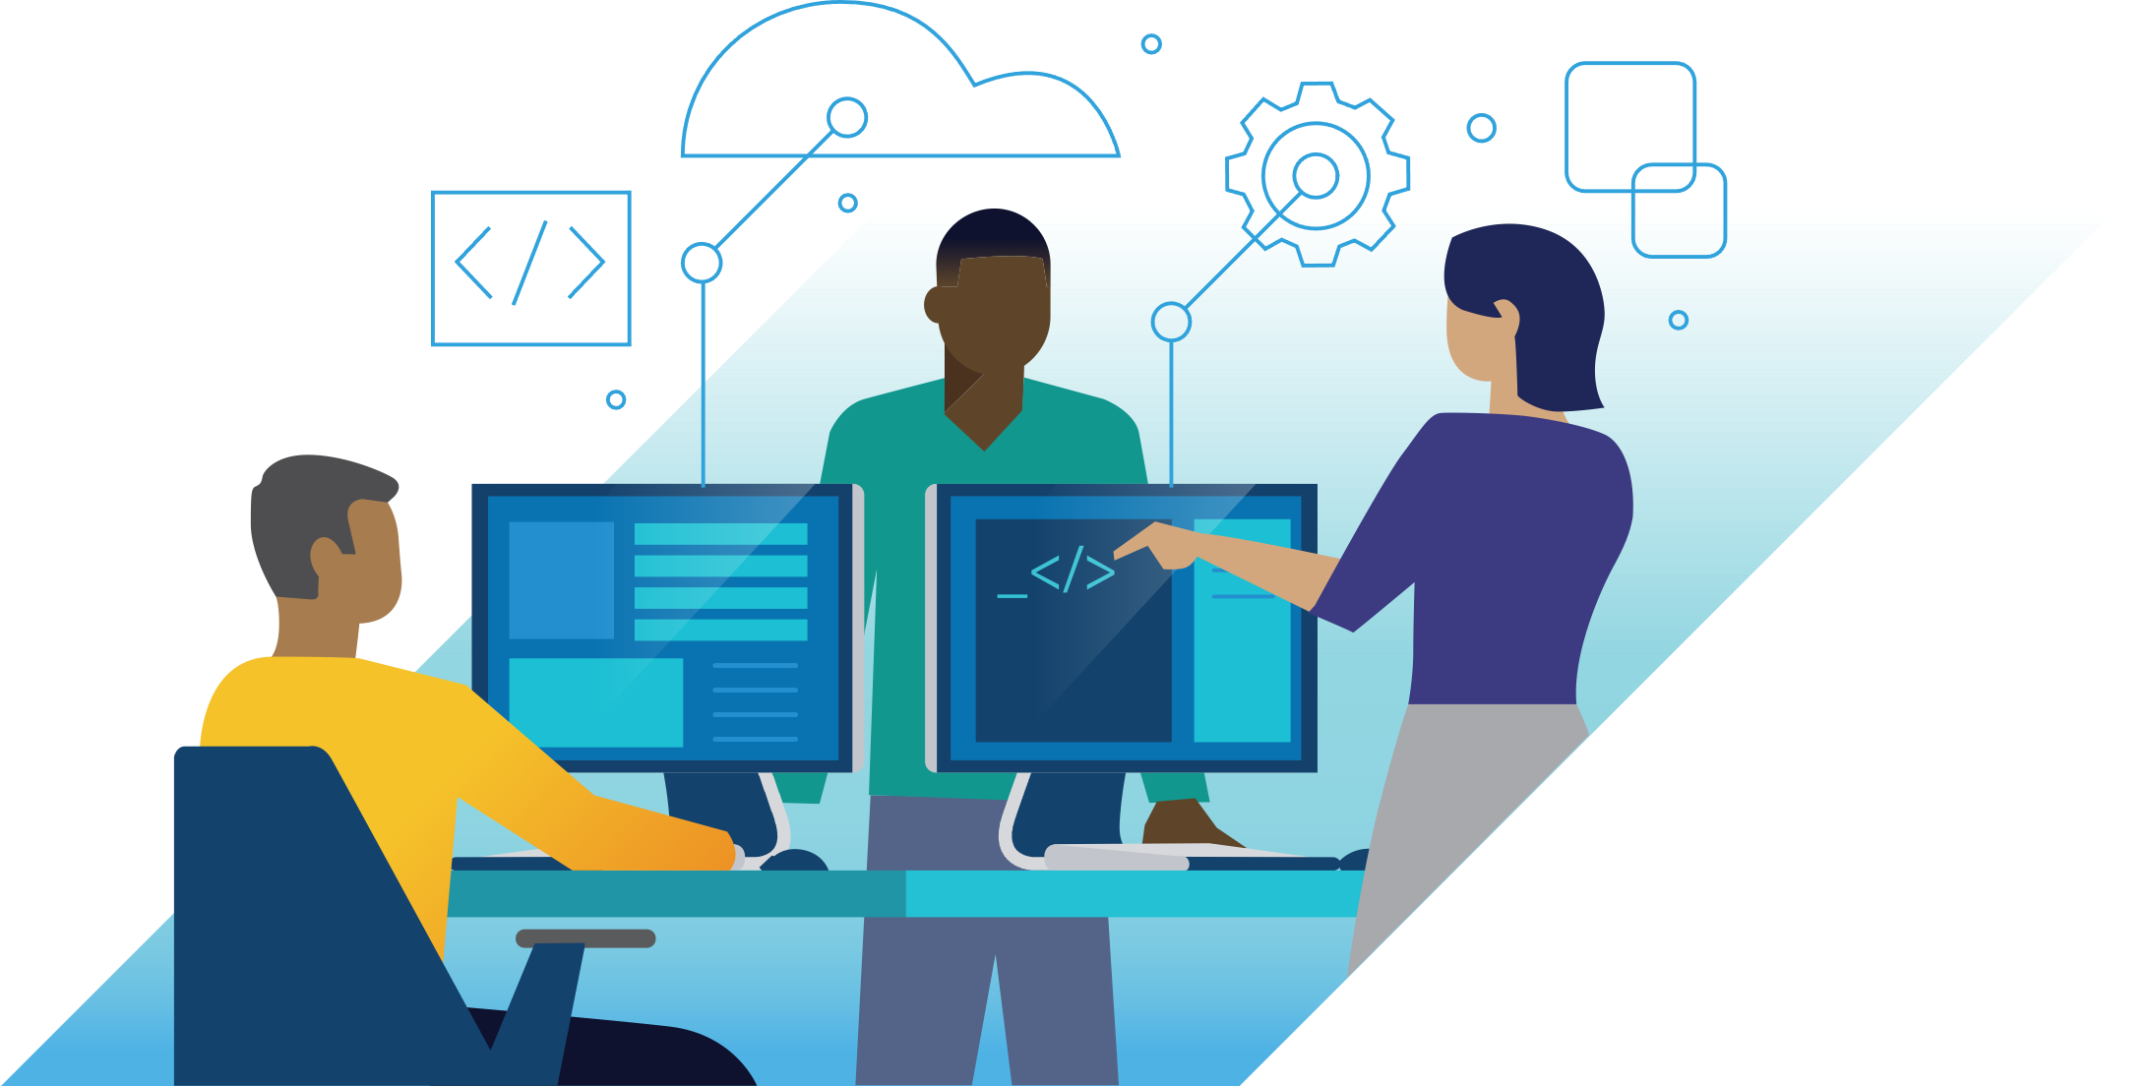
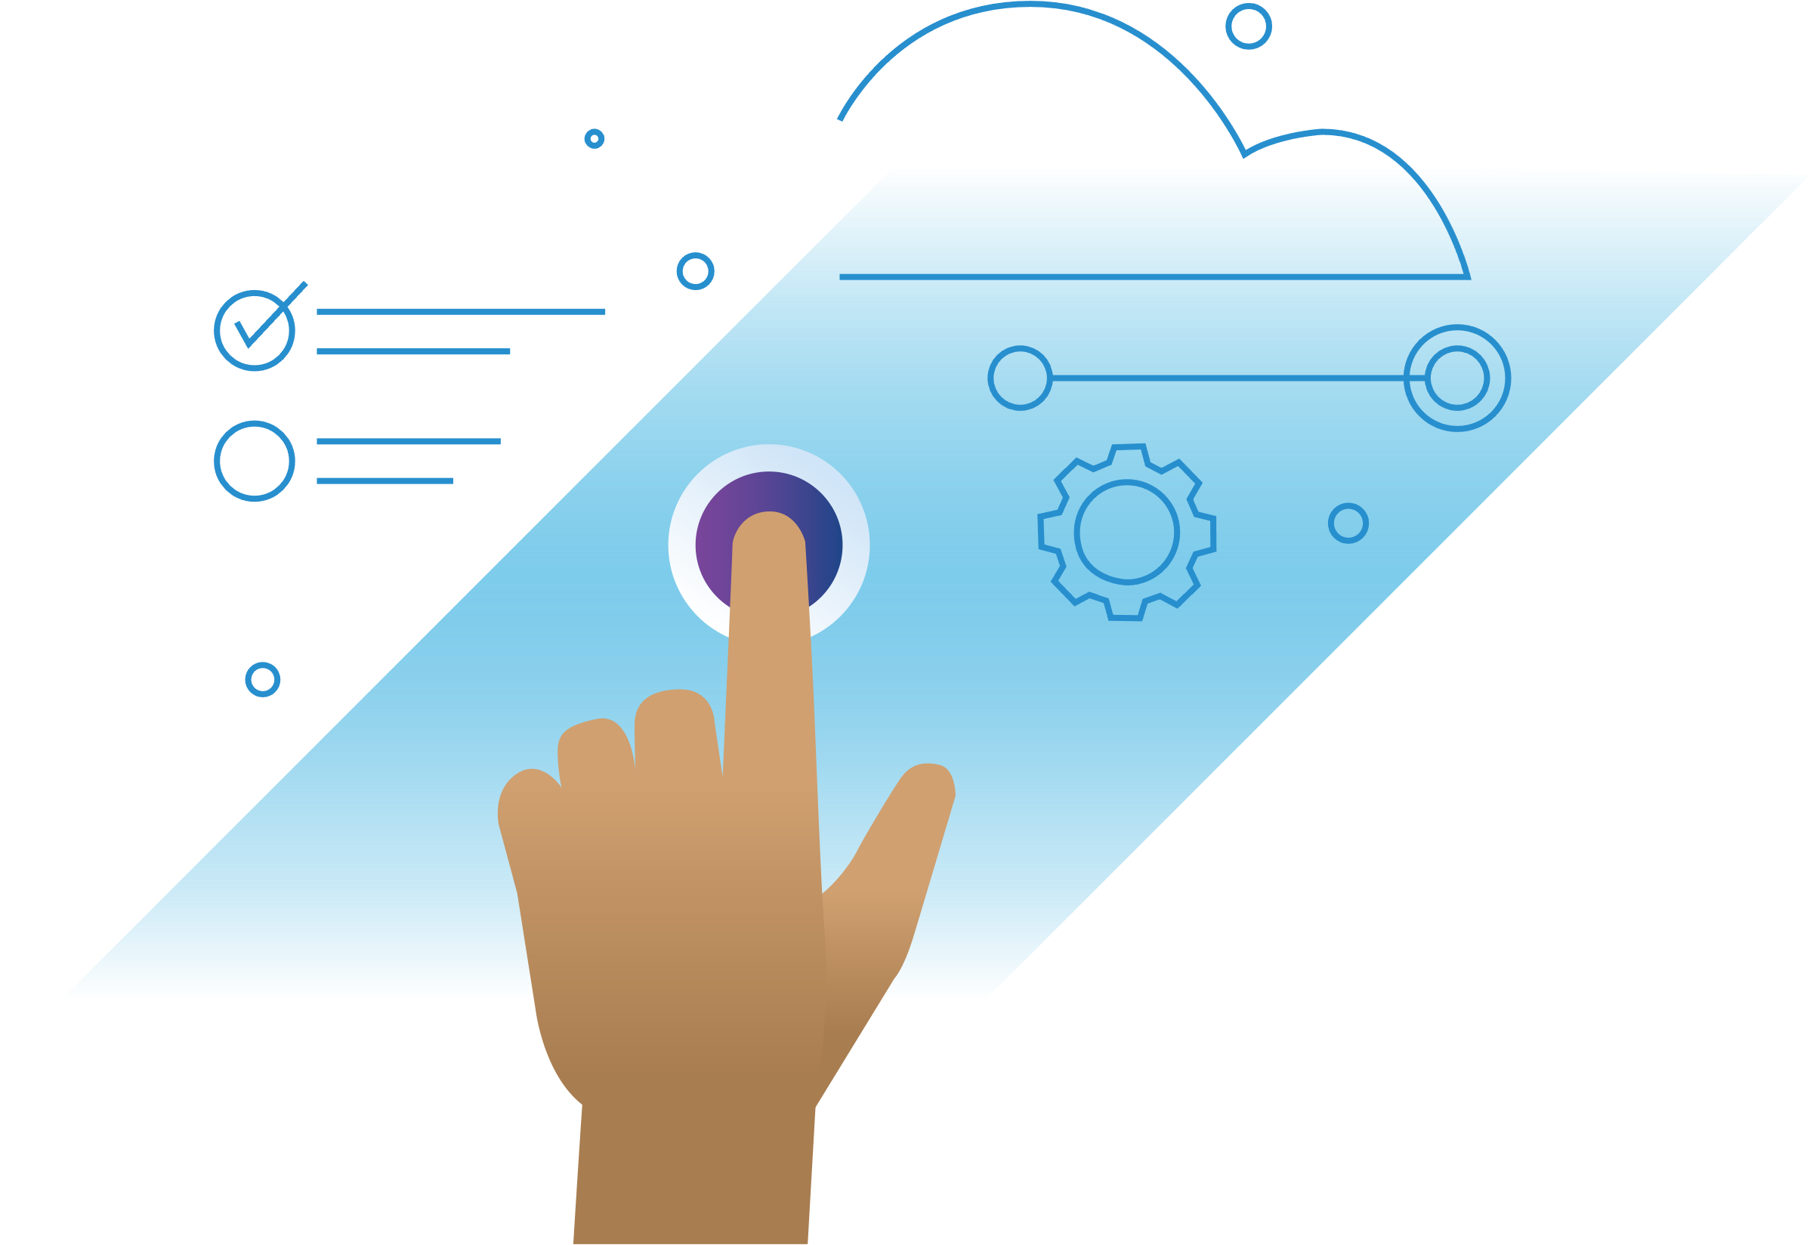
VMware Pro Cloud Services
Achieve the benefits of your future state architecture faster
Providing a well-architected solution encompassing technology, people and processes
Prescriptive Reference Architectures
Built from our breadth of customer deployments and best practices
Cross-Functional Team of VMware Experts
Brings the right skills at the right time for a coordinated effort
Flexible Delivery Model
Combines a standardized approach with customization options
Notes:
VMware Pro Cloud Services can help you achieve the benefits of your future state architecture faster, while freeing your IT resources to focus other priorities. Our family of services leverage prescriptive reference architectures which we developed based on our breadth of customer deployments and best practices for a consistent, predictable and reliable solution. A cross functional team of VMware experts brings together the rights skills at the right time for a coordinated effort focused on helping you achieve your objectives. Our flexible delivery model is based on a standard approach for consistency and repeatability while allowing some customization options.

Slide 5
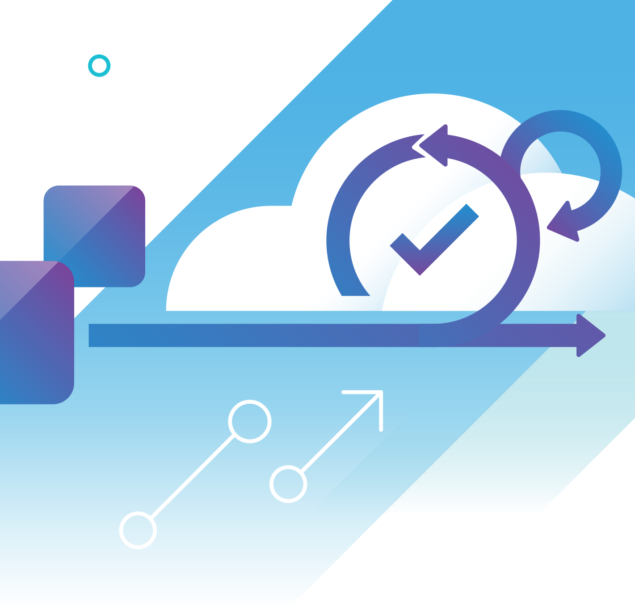
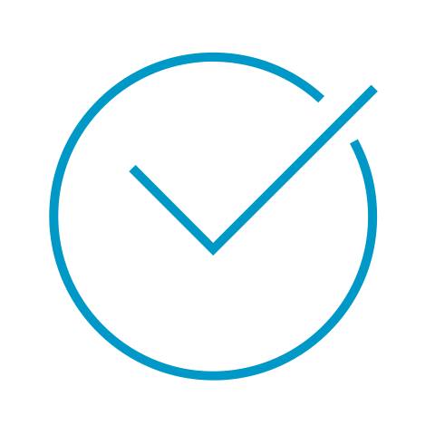
A Standardized, Repeatable and Prescriptive Approach
Reduces risk and complexity
Proven VMware design patterns
Defined metrics for success
Implementation best practices
Custom tools and delivery automation
Flexible sizing to support scalability and growth
Integration with existing and 3rd party solutions
Notes:
Our standardized, repeatable and prescriptive approach helps to reduce risk and complexity. Our services combine the key components of delivery excellence such as proven VMware design patterns, implementation best practices, defined metrics for success, custom tools and delivery automation to deliver faster and more reliably. We offer flexible sizing that will support your scalability and growth for your needs today and tomorrow. Customizations include integrations with your existing and third-party solutions.

Slide 6

Delivered By a Team of Experts Spanning Diverse Functions
Solution Architecture
Determine KPIs and metrics
Design and architect elements, sizing, and integration points
Deploy, integrate, configure the environment
Organization Change Management
Review the organizational model
Develop the organizational plan
Project Governance
Oversee the engagement
Prioritize and align resources
Maintain the project plan
Guide the implementation to fit the organization and business strategy
Notes:
VMware Pro Cloud Services are delivered by a team of VMware experts with specialized knowledge and skills across different technology, people, and process areas. This “pod” approach ensures you get the right skills at the right time and a coordinated effort for improved communication and collaboration, and ultimately faster time to value.

Slide 7
General Terms and Definitions
VMware Pro Cloud Services for Private Cloud
Environment
Instance
Datacenter
Workload Domain
Management Workload Domain
Virtual Infrastructure (VI) Workload Domain
A tag used to describe the function of a system. Common environment tags include Development, Test, UAT, and Production.
A tag used to describe a tangible deployment of a system. Example: the naming convention of the production instance of VCF Automation is VCFA-PROD.
The physical location of the instance. Example: the appliances are deployed to a cluster in the Boston datacenter.
The logical units that carve the compute, network, and storage resources of a single vCenter and a single NSX Manager.
A workload domain whose resources are dedicated to hosting VMware appliances.
A workload domain whose resources are dedicated to hosting non-VMware workloads.
Telemetry
Automation
Cloud
Private Cloud
Public Cloud
Multi Cloud
The recording and transmission of data from one or more systems to a centralized location for monitoring and analysis.
A series of tasks performed within minimal human input.
A style of computing in which scalable and elastic IT-enabled capabilities are delivered as a service using internet technologies.
A cloud that is developed and operated by the same entity who owns the datacenter where the cloud resides.
A cloud that is developed and operated by a different entity who owns the datacenter where the cloud resides.
A cloud comprised of public clouds and private clouds.
VCF Operations Fleet Management
VCF Automation
VCF Automation Orchestrator
VCF Operations
VCF Operations for Logs
VCF Operations for Networks
A platform responsible for deploying, upgrading, configuring, and managing the Aria Suite.
An automation platform designed to develop, control, and secure self-service capabilities of a cloud.
A platform that works in conjunction with VCF Automation to automate self-service processes.
A platform that provides full-stack visibility of a cloud by providing optimization, capacity, costing, and planning metrics.
A platform that provides intelligent log management and analytics of a cloud.
A platform that provides intelligent network analytics of a cloud.

Slide 8
VMware Pro Cloud Services
Private Cloud Conceptual Design

Slide 9



What is IaaS?
Focus on the Customer’s Customer
Infrastructure as a Service (IaaS) is a type of cloud computing service that offers essential compute, storage, and networking resources on demand.
What is a Service?
A cloud computing service is a mechanism to facilitate the request and the delivery of technology using an interface.
What are compute, storage, and networking resources?
Compute, storage, and networking resources are systems that handle data. “Compute” refers to a system that processes data, “Storage” refers to a system that stores data, and “Network” refers to a system that transports data.
Thanks… but what does this have to do with VCF?
Because IaaS drives consumption of VCF

Slide 10
Running IaaS on VMware
Goal: Deliver a Hyperscaler Experience with VMware
Primary Roles
Core Capabilities
Key Benefits
Prescriptive approach to development and and operations
Improved agility and cost efficiency
Continuous improvement
Simplified marketplace for consumer
Physical / Virtual IaaS
Marketplace to build, destroy and rebuild Infrastructure
Monitor and log requests
Management of capacity, Availability and performance
Operational cost calculations
Compliance policies
IaaS Developer
IaaS Administrator
IaaS Approver
IaaS Consumer
NEW ROLE
Notes:
IaaS on VMware provides a prescriptive approach to:
Develop and operate the VMware Cloud with improved agility and cost efficiency.
Continuously improve a simplified marketplace experience for the consumer.
IaaS on VMware provides the tools and processes to build, operate, scale, and secure IaaS for the following roles:
IaaS Developer – needs the ability to develop and release new IaaS service offerings to the marketplace.
IaaS Administrator - needs the ability to guarantee the reliability of the marketplace.
IaaS Approver – needs the ability to govern the security, compliance, cost, and architecture of the marketplace.
IaaS Consumer – needs the ability to request a resource pool (compute, network, or storage) or operating system from the marketplace
IaaS on VMware provides the following set of capabilities:
Two infrastructure service offerings:
Physical IaaS: a workload domain as a service (AWS equivalent: VPC)
Virtual IaaS: an operating system as a service (AWS equivalent: EC2)
Ability for IaaS Consumers and IaaS Developers to build, destroy, and re-build the infrastructure through a self-service marketplace, where the marketplace is accessible through an IAM controlled interface.
Ability to monitor and log each marketplace request, automatically alerting IaaS Administrators when there are problems.
Ability for IaaS Administrators to manage capacity, availability, and performance of the underlying resources to ensure the IaaS service offering does not encounter single points of failure or degradation of the user experience.
Ability to capture and present the operational cost to IaaS Approvers.
Ability for IaaS Administrators to push compliance policies defined by the IaaS Approvers to assets under management.

Slide 11
What is a Conceptual Design?
Terms and Definitions
A Conceptual Design is an element of the High-Level Design that outlines the goals and structure of an enterprise system.
The scope of the enterprise system may range from a specific domain such as network or infrastructure to a larger design encompassing many or all domains.

Slide 12
VMware Pro Cloud Services for Private Cloud
Conceptual overview
Multi-Tenant Consumers and Services
LOBs
Devs and SREs
Platform Teams
Integrations and 3rd Party Ecosystem
Consumption
Self-Service Portal
API | CLI | CI/CD
Infra-as-Code
Security Governance and Compliance
Data Protection
and Recovery
Data Services
App Runtime Services
AI/ML Services
LBaaS Services
Identity and RBAC
IaaS | CaaS | PaaS | XaaS
Data Protection
Auditing and SIEM
Disaster Recovery
Automated Operations
Constraint-Based Management
Performance Optimization
Visibility and Observability
Analytics and Reporting
Disaster Avoidance
Data Governance
Cost Efficiency Management
Capacity Management
Configuration Management
Ransomware Recovery
Compliance Enforcement
Virtualized Infrastructure
Compute
Storage
Network
Any Hardware
Notes:
Talk Track:
This slide outlines the key elements that constitute a modern private cloud. The core pillars—Security Governance and Compliance, Management, Automated Operations, Data Protection and Recovery, and Virtualized Infrastructure—form the backbone of the private cloud. While the specific sub-components can be tailored to meet different needs, the general construct remains the same. This flexibility allows organizations to build a private cloud that is secure, efficient, and resilient, tailored to their specific requirements. Security Governance and Compliance
• Identity and RBAC (Role-Based Access Control): Ensures secure access management.
• Auditing and SIEM (Security Information and Event Management): Provides monitoring and auditing capabilities.
• Constraint-Based Management: Enforces policies and constraints for compliance.
• Data Governance: Manages data integrity and privacy.
• Compliance Enforcement: Ensures adherence to regulatory standards.
Management
• Self-Service Portal: Allows users to access and manage resources independently.
• API | CLI | CI/CD: Facilitates automation and integration through various interfaces.
• Infra-as-Code: Enables infrastructure management through code for consistency and repeatability.
• Data Services: Manages data storage and retrieval.
• App Runtime Services: Provides environments for running applications.
• AI/ML Services: Supports artificial intelligence and machine learning workloads.
• LBaaS Services: Offers Load Balancer as a Service for optimal traffic distribution.
Automated Operations
• Performance Optimization: Enhances system performance.
• Visibility and Observability: Provides insights into system health and operations.
• Analytics and Reporting: Delivers actionable data insights.
• Cost Efficiency Management: Controls and reduces operational costs.
• Capacity Management: Ensures adequate resource provisioning.
• Configuration Management: Maintains and manages system configurations.
Data Protection and Recovery
• Data Protection: Safeguards data against loss and breaches.
• Disaster Recovery: Plans for quick recovery from disruptions.
• Disaster Avoidance: Proactively prevents potential disasters.
• Ransomware Recovery: Specialized recovery procedures for ransomware attacks.
Virtualized Infrastructure
• Compute (vSphere): Provides virtualized computing resources.
• Storage (vSAN): Offers scalable storage solutions.
• Network (NSX): Delivers comprehensive network virtualization and security.

Slide 13
IaaS Conceptual Design
Example Goal: get a compliant VM in less than 30min
Thought Drivers:
Encourage designs to only include integrations that are critical to the service offering.
Encourage lean as possible principal for every process to reduce excess wait times of each integration.
Shift Left improving consistency, reducing integration risks, and improving reliability (Reference: the Shift Left theory as explained by Dynatrace).
Supporting Goals and Decision Log Summary:
All build VMs will follow a generated name unique to each build. The VMIAD service team will be the owner of the name generation.
No remote calls from guest OS. Remove all orchestration from the Guest OS calling to parent orchestration layer.
No application specific integrations (for example: ISP) for obtaining the status of a VM. Front end will provide status via a pull or a subscription agnostic to the integration that VMIAD service team publishes. Target: migrate all publishing statuses to Kafka.
Incorporate as much of the “post-configuration” activities into the image using a VM Template.
No de-registration during the build process. De-register during the decom process only.
No patching during the build process. Target: maintain a “30 day good” image using an image pipeline.
Remove application specific build steps from the process. VMIAD process should only include steps to ensure compliance of the Guest OS.
Ensure Guest OS meets criteria for “Operational Readiness” at the end of a VMIAD build in Non-Prod.
Use native provider services (for example: VCF Automation Infoblox plugin) for critical endpoint integrations.
Testing must be automated, and all tests must be coded. At the conclusion of the build, validation checks must ensure the Guest OS meets compliance standards, and validation checks must ensure that the customer is able to access the Guest OS.

Slide 14
VMware Pro Cloud Services for Private Cloud
Logical Design

Slide 15
What is a Logical Design?
Terms and Definitions
A Logical Design is an element of the High-Level Design that provides a point in time snapshot to a specific element of a conceptual design. For example, if the conceptual design outlines the goals and structure for a network, the logical design may provide vendor details, integration points, network flow, and similar configurations that are associated with the network design.
The logical design is the lowest level of detail in the High-Level Design. The logical design should provide enough information to start a draft of a Low-Level Design. A Low-Level Design typically provides the configuration level detail of a design. It is typically developed in conjunction with the build of the system itself. Therefore, the logical design in the High-Level Design must contain enough information to start the build.

Slide 16
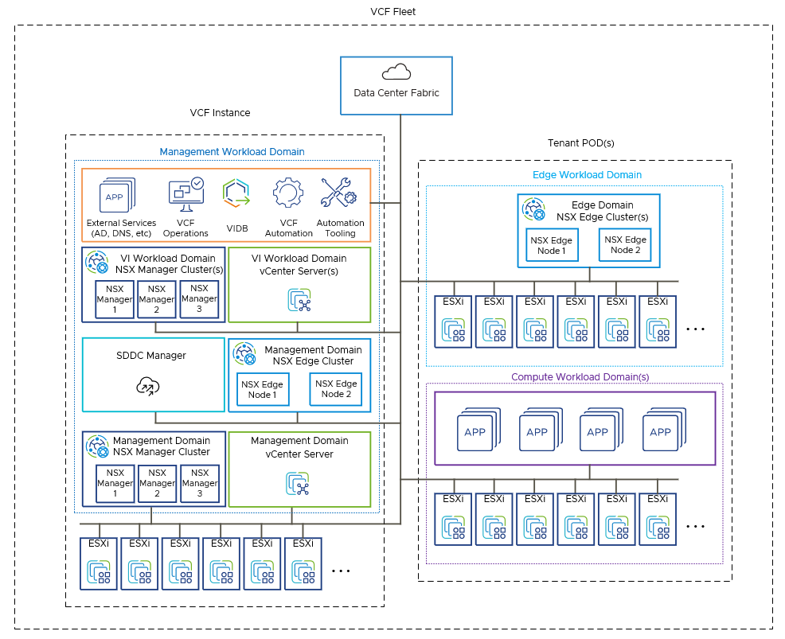
Private Cloud Logical Role Design
Delivering IaaS with VMware Cloud Foundation

Slide 17
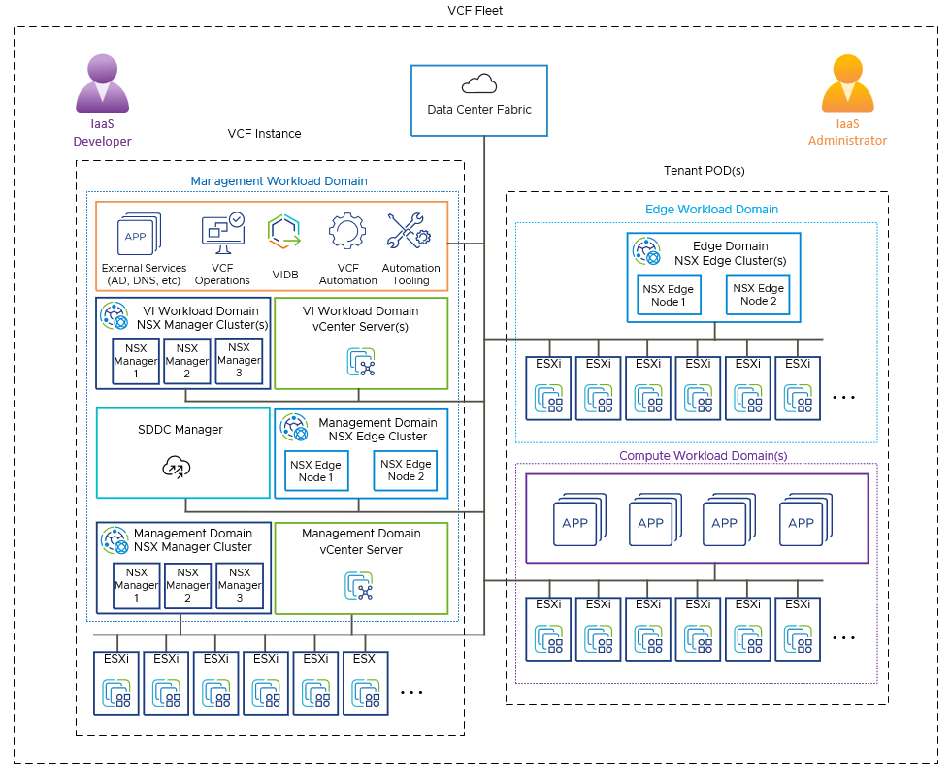
Private Cloud Logical Role Design
Delivering IaaS with VMware Cloud Foundation
1
IaaS Administrator
Deploys ESX Hosts for Management Domain with already provisioned hardware.
VCF Installer is used to deploy the Management Domain specific components including: vCenter Server, NSX Managers, SDDC Manager, VCF Operations, and VCF Operations Fleet Manager.
Base configuration of NSX Edge, and Virtual Networking, VCF Automation, and Automation Tooling completed for the Management Workload Domain.
IaaS Developer
Works with the IaaS Administrator persona to create the automation for Automation of Tenant Pods.
Tenant Pods deployed via environmental specifications for tenant workloads to provide IaaS Administrators with consistent operations.
2
3
2
2
3
2
2
1

Slide 18
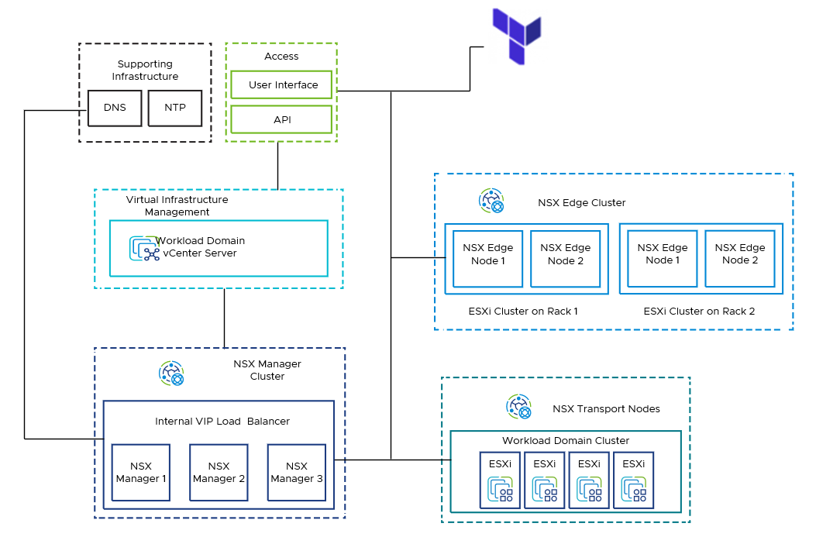
Private Cloud Logical Role Design for SDN
Delivering IaaS with NSX
Deploy NSX Edge Cluster for Workload Domain with Automation (Uplink Profile - Transport Zone - Uplink Segments)
Deploy NSX Edge-VMs
Base Configuration for Logical-Routing configuration leveraging BGP (ECMP) for Management and Workload Domain
Deploy base DFW configuration for Macro-Segmentation for basic shared services
1
2
3
4
Notes:
# NSX Private-Cloud Model - Rack Layout - Three (3) Compute racks - Edge-Cluster Model - Two (2) rack/fault-domain topology, with a minimum of two (2) hosts for edge compute resources

Slide 19
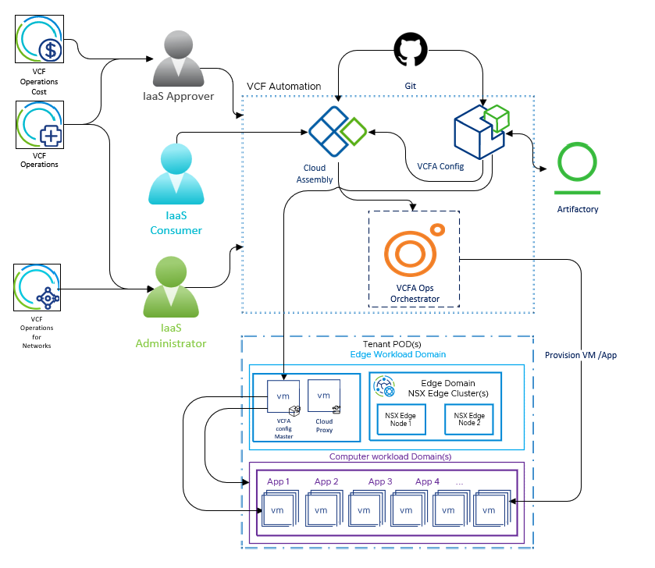
Private Cloud Assembly Logical Role Design
Delivering IaaS with VCF Automation
1
1
Download VMware Pro cloud service config files from git.
Download packages from Artifactory for application deployment.
Use the VCF Automation Cloud Template to provision virtual server(s) or application stack.
Apply VCF Automation Config state file to configure the servers and applications.
Apply appropriate VCF Automation Config state file to maintain desired state of the application/VM.
2
3
Delivers Complete Operational Transparency of Cost, Operations and Compliance to both IaaS Approver and IaaS Administrators.
4
5

Slide 20
VMware Pro Cloud Services for Private Cloud
VMware Cloud Foundation Logical Architecture Patterns

Slide 21
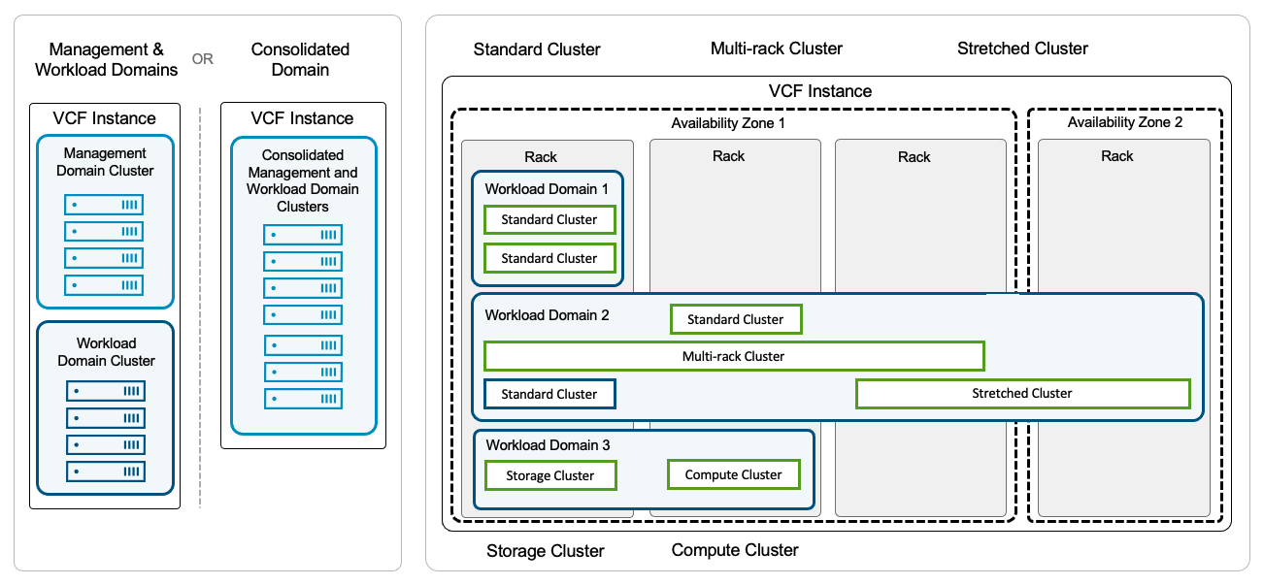

Scale-Aligned Implementation(s)
Starting platform minimums to enable customers and PSO delivery teams.
Prescriptive Reference Architecture
Built from our breadth of customer deployments and best practices
Flexible Delivery Model
Combines a prescriptive approach with flexibility to adapt to your deployment needs. Seamlessly transition FSA/FSD to PSO deployment teams for rapid deployment.

Slide 22
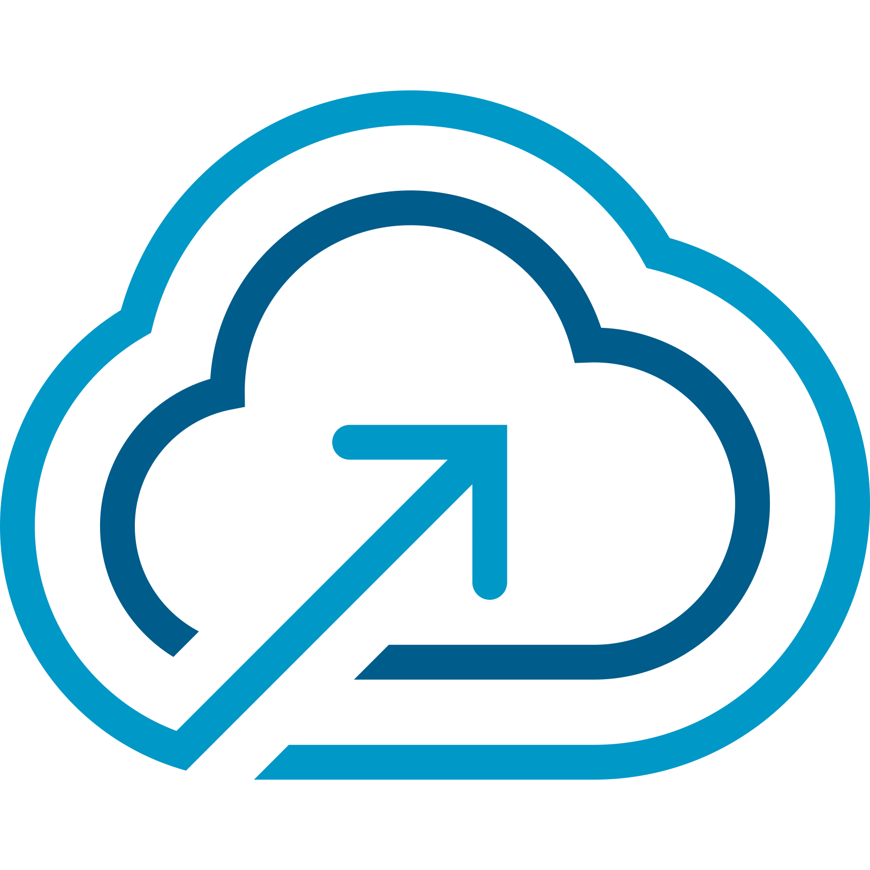
Private Cloud Logical Design within VMware Cloud Foundation
VCF Private Cloud
VCF Fleet
VCF Fleet
VCF Fleet
VCF Automation
VCF Automation
VCF Automation
VCF Operations
VCF Operations
VCF Operations
VCF Instance
Management Domain
Workload Domains
VCF Fleet
One or more VCF instance
Common VCF Operations instance
Common VCF Automation Instance
VCF Private Clouds
One or more VCF Fleets
VCF Instance
VCF Instance
VCF Instance
Management Domain
Management Domain
Management Domain
vCenter
vCenter
vCenter
NSX
NSX
NSX
SDDC Manager
SDDC Manager
SDDC Manager
Clusters
Clusters
Clusters
Clusters
Core Infrastructure
Core Infrastructure
Core Infrastructure
Additional Workload Domains
Additional Workload Domains
Additional Workload Domains
vCenter
vCenter
vCenter
NSX
NSX
NSX
Clusters
Clusters
Clusters
Core Infrastructure
Core Infrastructure
Core Infrastructure
Additional VCF Instances
Additional VCF Instances
Additional VCF Instances
Notes:
Presenter Note – this slide contains animation.
Key Message: VCF Architecture can be defined following three (3) private cloud constructs. Talk Track: In order to understand the constructs of a VCF Private Cloud, you need to be familiar with VCF Instances and VCF Fleets. The first vSphere cluster of a VCF instance is configured as part of a management domain and is used to host the management components. The SDDC Manager appliance is deployed to the management domain.
<click 1>
Additional workload domains can be created to scale a deployment which are each configured with their own vCenter server and a single or shared NSX instance.
<click 2>
A VCF Fleet can be comprised of one of more VCF instances and is managed by a single set of fleet-level management components. Fleet management components comprise of a single instance of VCF Operations and a single instance of VCF Automation. The VCF Operations and VCF Automation instances can be used across all domains within a VCF instance and across one or more VCF instances. A VCF Fleet can be deployed across a single region or a dual region deployment.
<click 3>
A VCF Private Cloud is the highest level of management and consumption for the underlying software defined data center resources. A VCF Private Cloud can contain one of more VCF Fleets. Notes:
Resources:
Refer to the VMware Cloud Foundation Design Guide for further information https://techdocs.broadcom.com/us/en/vmware-cis/vcf.html

Slide 23
Workload Domain and Cluster Topologies
Management & Workload Domains
OR
Consolidated Domain
Standard Cluster
Multi-rack Cluster
Stretched Cluster
VCF Instance
VCF Instance
VCF Instance
Availability Zone 1
Availability Zone 2
Management Domain Cluster
Consolidated Management and Workload Domain Clusters
Rack
Rack
Rack
Rack
Workload Domain 1
Standard Cluster
Standard Cluster
Workload Domain 2
Standard Cluster
Workload Domain Cluster
Multi-rack Cluster
Standard Cluster
Stretched Cluster
Workload Domain 3
Storage Cluster
Compute Cluster
Storage Cluster
Compute Cluster
Notes:
Key Message:
Cloud Foundation workload domains and clusters can be deployed and configured in different ways.
Talk Track:
Cloud Foundation caters to a mix of different deployment options to support a large variety of customer scenarios.
A standardized architecture caters to customers who wish to separate their workloads from management components. Workload domains are deployed to separate hardware running their own separate vCenter server and NSX Manager instances. Workload domains are each configured with their own SSO instance. Once a domain is created vCenter Linking can later be configured from VCF Operations.
<click 1>
For smaller deployments, VCF can be deployed with just a single management domain. A consolidated deployment contains the management components and is also used to run customer workloads which can be configured on separate clusters. Resource pools are configured to separate host resources for management and customer workloads.
<click 2>
Workload domains can be deployed across one or more racks within an availability zone. Clusters can be configured as standard clusters within a single rack…
<click 3>
… or across multiple racks when layer 3 networking is in-place between the racks.
<click 4>
vSAN stretched clusters can be configured across two (2) sites for active-active availability. Availability Zones are configured as fault domains that protects VMs in a vSphere cluster leveraging vSAN replication. vSAN Stretched cluster protects VMs against partial host failures within the clusters, within a single data center and can be used to extend to multiple nearby facilities or buildings.
vSAN stretched clusters can be useful for:
Performing planned maintenance on an availability zone without any downtime. Each availability zone is configured as a fault domain. Applications can be migrated back after the maintenance is completed.
Stretching a cluster automatically initiates VM restart and recovery in the case of unplanned failures in either site.
Disaster avoidance by preventing service outages before an impending disaster.
<click 5>
vSAN Storage clusters (formerly vSAN Max) can also be used to provide highly scalable and flexible disaggregated storage for vSphere clusters, either as primary storage or to augment traditional vSAN HCI clusters. vSAN Compute clusters caan also be configured to enable vSphere clusters (including non-vSAN clusters) to consume storage resources from a remote vSAN cluster.
Notes:
Additional Information:
A Multi-Availability Zone Deployment Architecture adds additional layer of protections as hosts can stretch among multiple Availability Zone and which provides workload protection if a single Availability Zone is compromised. At the heart of the Multi Availability Zone Deployment is NSX’s ability to create distributed logical networks that seamlessly extend across AZs. By abstracting network functions from underlying hardware, NSX enables organizations to establish consistent network policies and configurations regardless of the physical infrastructure’s location. This allows for the creation of virtual network segments that span multiple AZs.
For further information on vCenter Linking please refer to Identity and Access Management section of this presentation.
vSAN Stretched Cluster will be discussed in more detail in the Stretched Cluster section of this presentation.
Resources:
Further detail on Cloud Foundation deployment options is covered in the VMware Cloud Foundation Product Documentation – VMware Cloud Foundation Administration Guide
https://docs.vmware.com/en/VMware-Cloud-Foundation/index.html
For further information on Cloud Foundation Deployment Options please refer to the VCF Design Guide
https://docs.vmware.com/en/VMware-Cloud-Foundation/index.html

Slide 24
Remote Site Topologies
Configure a Remote Workload Domain or a Remote Cluster
Provide presence for remote sites through centralized management
Place resources close to workers
Use VCF Operations to perform Fleet Management operations for each remote site
Choose the topology that best suits your requirements for:
Management
Scale
Networking
Bandwidth & latency requirements apply
VCF Operations
SDDC Manager
Workload Domain
Workload Domain
Workload Domain
Cluster
Cluster
Cluster
Cluster
Cluster
Cluster
Remote Workload Domain Example Workload Domain: 1 per site Clusters: 1 x cluster per domain
Central VCF DC Site
Remote Cluster Example Workload Domain: Per site or across sites Clusters: Multiple per domain
Notes:
Key Message:
Remote site topologies for VMware Cloud Foundation.
Talk Track:
Cloud Foundation supports the deployment of small workload domains or clusters to remote sites.
This allows customers to extend their compute processing from their centralized data center to support remote locations/offices. The management infrastructure to run these edge sites is shared and runs in the central data center.
Remote sites provide IT presence through centralized management without extra staffing. Customers can position infrastructure close to remote applications to minimize latency and overheads.
With each approach, VCF Operations is used at the central site to perform fleet management operations which includes password & certificate management and lifecycle management/upgrade and patching operations for each remote site.
<click>
Configure a Remote Workload Domain:
Initially the remote domain is composed with the vCenter Server located at the remote site. When configuring vCenter Linking the vCenter Server can be managed from the central data center. This can be handy for organizations which don’t have remote IT resources.
Each remote site is configured with a domain and a single vSphere cluster. A separate NSX instance is deployed per domain providing a full SDN solution with overlay networking.
<click>
Configure at remote Cluster. With this approach the vCenter Server is co-located with the cluster at the remote site where it can be managed remotely.
Each domain can be composed with multiple clusters per site and each domain can consist of clusters configured across multiple sites.
When configuring a remote cluster in this way vSphere Networking is used.
Additional Information:
Example use cases:
o Video Surveillance
o Point of Sales Retail
o Federal: mobile battlefield
o SLED: distributed citizen engagement
o Distributed Healthcare
o Oil and Gas Exploration
o Academic: Distributed Education and Research Computing
Notes:
Remote sites are not initially configured using VCF Operations / SDDC Manager. Follow the VCF documentation to deploy a remote cluster or workload domain.
VCF remote site topology connectivity requirements: - 10MBps min connectivity between sites - Less than 100ms latency between sites. - Two (2) connections between each site is also recommended.
- A remote cluster configured with vSAN can be configured using 3 - 16 nodes.
- A remote cluster can be configured with NFS or VMFS on FC as Principal storage with 2 - 16 nodes.
VMware Kubernetes Service (VKS) can be configured on a cluster deployed at a remote site. - vCenter Server is used to perform scaling operations for remote workload domains and remote clusters.
Customers can choose to use VCF Edge licensing with 10 or more sites.
A remote cluster or workload domain is not to be confused with VCF Edge (see appendix)
Resources:
Further detail on VCF deployment topologies and additional deployment scenarios are discussed in this whitepaper:
ttps://www.vmware.com/docs/vcf-edge-considerations-white-paper
For further information on Cloud Foundation Deployment Options please refer to the VCF Design Guide
https://docs.vmware.com/en/VMware-Cloud-Foundation/index.html
Further detail on Cloud Foundation deployment options is covered in the VMware Cloud Foundation Product Documentation – VMware Cloud Foundation Administration Guide.
https://docs.vmware.com/en/VMware-Cloud-Foundation/index.html

Slide 25
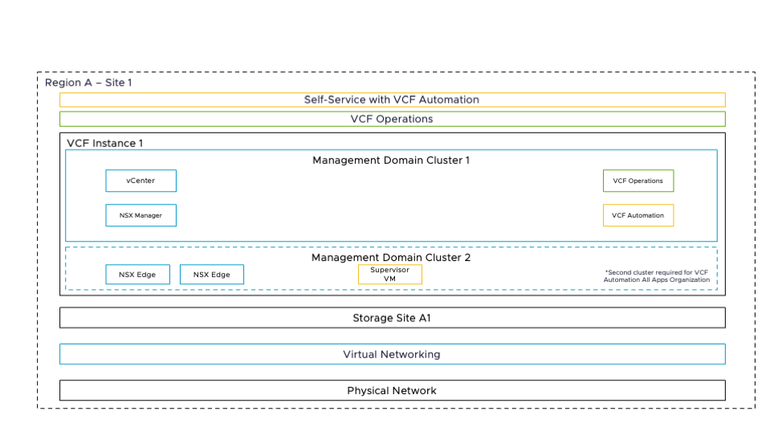
VCF Design
Logical Design - VCF Fleet in a Single Site with Minimal Footprint
Physical Site Configuration:
Single Site (Single Instance)
Availability
Tolerates failure of a single ESX host
Tolerates failure of an individual network path
Isolation
Hypervisor-Based (Logical Isolation)
Tenant / Tenant Isolation
Recoverability
Not well suited for adding a disaster recovery solution.
Backup and restore functionality can provide a recovery option

Slide 26
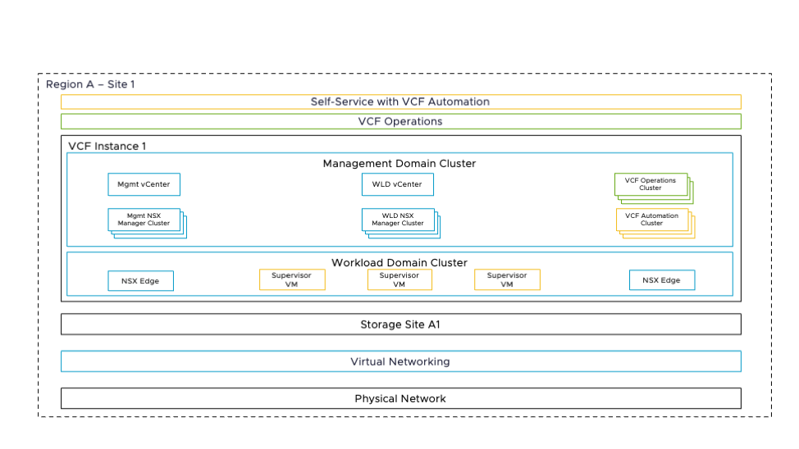
VCF Design
Logical Design - VCF Fleet in a Single Site
Physical Site Configuration:
Single Site (Single Instance)
Availability
Tolerates failure of a single ESX host
Tolerates failure of an individual network path
Tolerates failure of a single rack *
Tolerates failure of a single management component
Isolation
Hypervisor-Based (Logical Isolation)
Network traffic type isolation
Cluster-based (physical isolation)
Tenant / Tenant Isolation
Recoverability
Not well suited for adding a disaster recovery solution.
Backup and restore functionality can provide a recovery option

Slide 27
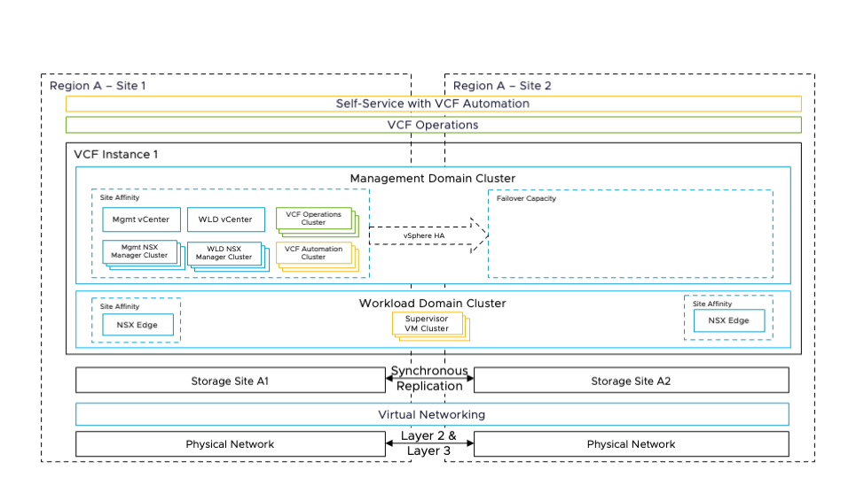
VCF Design
Logical Design - VCF Fleet with Multiple Sites in a Single Region
Physical Site Configuration:
Multiple Sites within a single region (Single instance, stretched cluster between the sites for maximum availability)
Availability
Tolerates failure of a single ESX host
Tolerates failure of an individual network path
Tolerates failure of a single rack (vSAN Stretch Cluster)
Tolerates failure of a single management component
Tolerates failure of a single availability zone
Isolation
Hypervisor-Based (Logical Isolation)
Network traffic type isolation
Cluster-based (physical isolation)
Tenant / Tenant Isolation
Recoverability
Recovery to a second site Available.
Backup and restore functionality can provide a recovery option

Slide 28
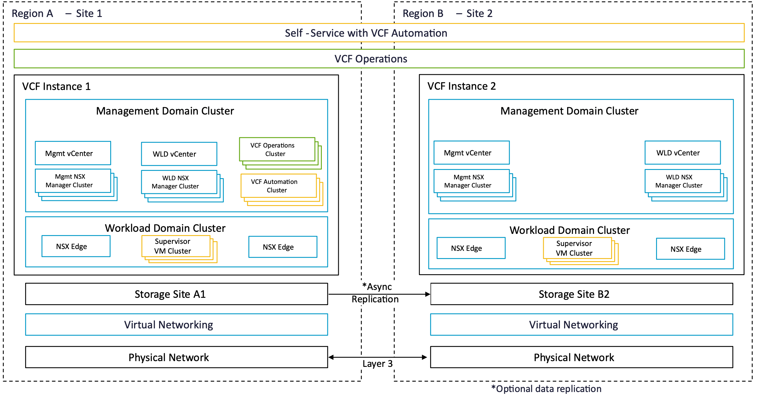
VCF Design
Logical Design - VCF Fleet with Multiple Sites Across Multiple Regions
Physical Site Configuration:
Multiple Sites (across multiple regions)
Availability
Tolerates failure of a single ESX host
Tolerates failure of an individual network path
Tolerates failure of a single rack (Rack Fault tolerance via the Multi-Rack Cluster Model)
Tolerates failure of a vSphere cluster
Tolerates failure of a single management component
Isolation
Hypervisor-Based (Logical Isolation)
Network traffic type isolation
Cluster-based (physical isolation)
Tenant / Tenant Isolation
Recoverability
Recovery to a second site available when augmented with a data replication solution.
Backup and restore functionality can provide a recovery option

Slide 29
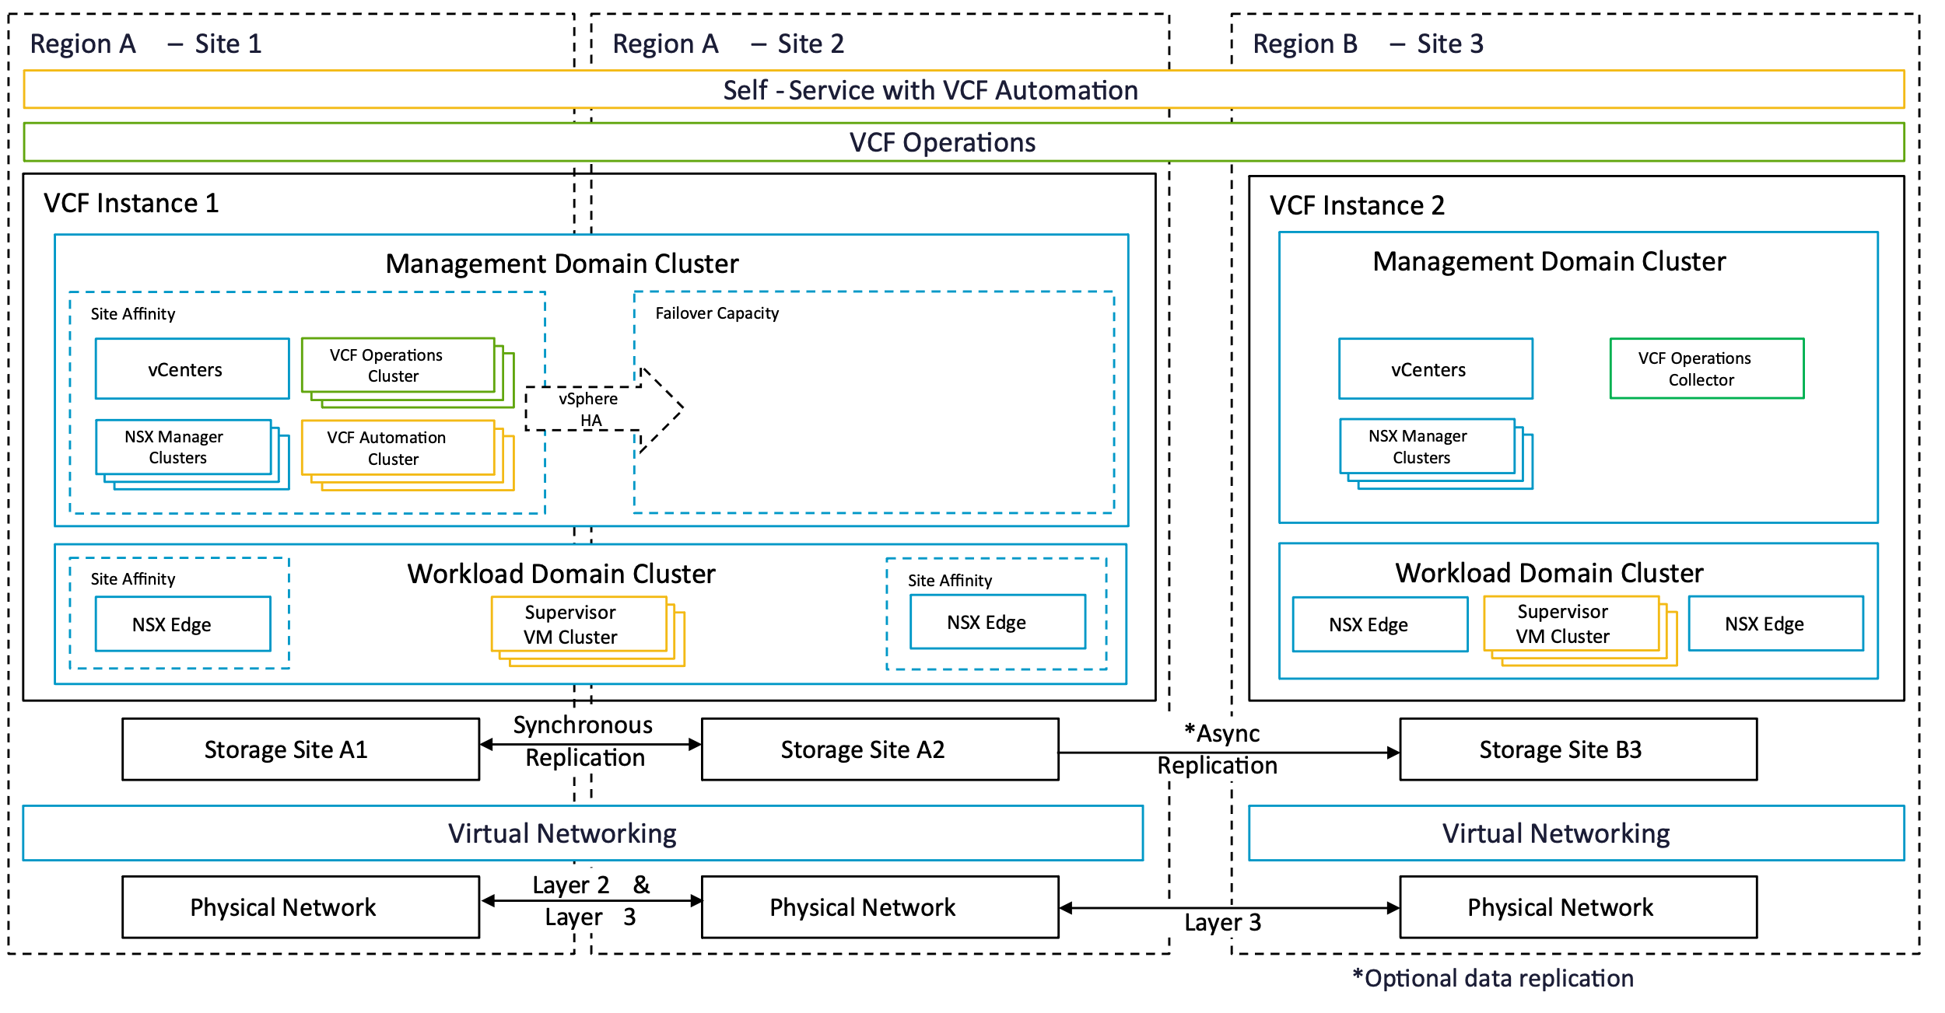
VCF Design
Logical Design - VCF Fleet with Multiple Sites in a Single Region plus Additional Region(s)
Physical Site Configuration:
Multiple Sites in a Single Region
Multiple Sites across multiple regions
Availability
Tolerates failure of a single ESX host
Tolerates failure of an individual network path
Tolerates failure of a single rack (vSAN Stretched cluster model)
Tolerates failure of a vSphere cluster
Tolerates failure of a single management component
Tolerates the failure of a single availability zone
Isolation
Hypervisor-Based (Logical Isolation)
Network traffic type isolation
Cluster-based (physical isolation)
Tenant / Tenant Isolation
Recoverability
Recovery to a both single site and secondary second site available.
Backup and restore functionality can provide a recovery option

Slide 30
VMware Pro Cloud Services for Private Cloud
Networking Architecture Patterns

Slide 31
Distributed Switch Models

Slide 32
Distributed Switch Models
Single
Distributed Switch
Storage Separation
Distributed Switch
Workload Separation
Distributed Switch
Storage and Workload Separation
Distributed Switch
ESX Host
ESX Host
ESX Host
ESX Host
VM Mgmt
vDS Uplinks
VM Mgmt
vDS Uplinks
VM Mgmt
vDS Uplinks
VM Mgmt
vDS Uplinks
ESX Mgmt
ESX Mgmt
ESX Mgmt
ESX Mgmt
vMotion
vMotion
vMotion
vMotion
Storage
Virtual Networking
Storage
vDS Uplinks
Storage
Virtual Networking
vDS Uplinks
vDS Uplinks
Storage
Virtual Networking
vDS Uplinks
Virtual Networking

Slide 33
NSX Edge Cluster Models
Single Availability Zones

Slide 34
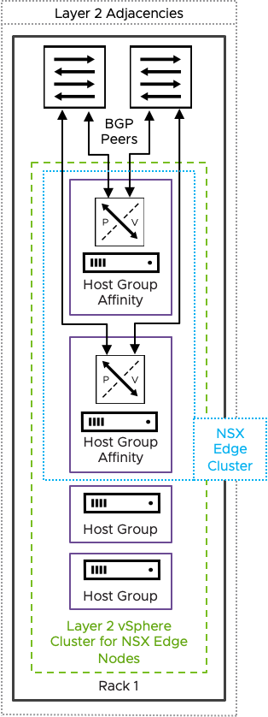
NSX Edge Cluster Architecture
Host Fault Tolerant NSX Edge Cluster

Slide 35
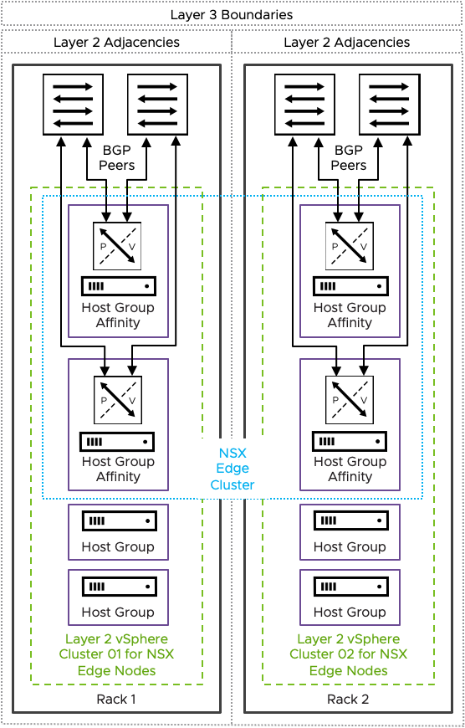
NSX Edge Cluster Architecture
Rack Fault Tolerant Design using two or more vertical Layer 2 vSphere clusters in separate racks

Slide 36
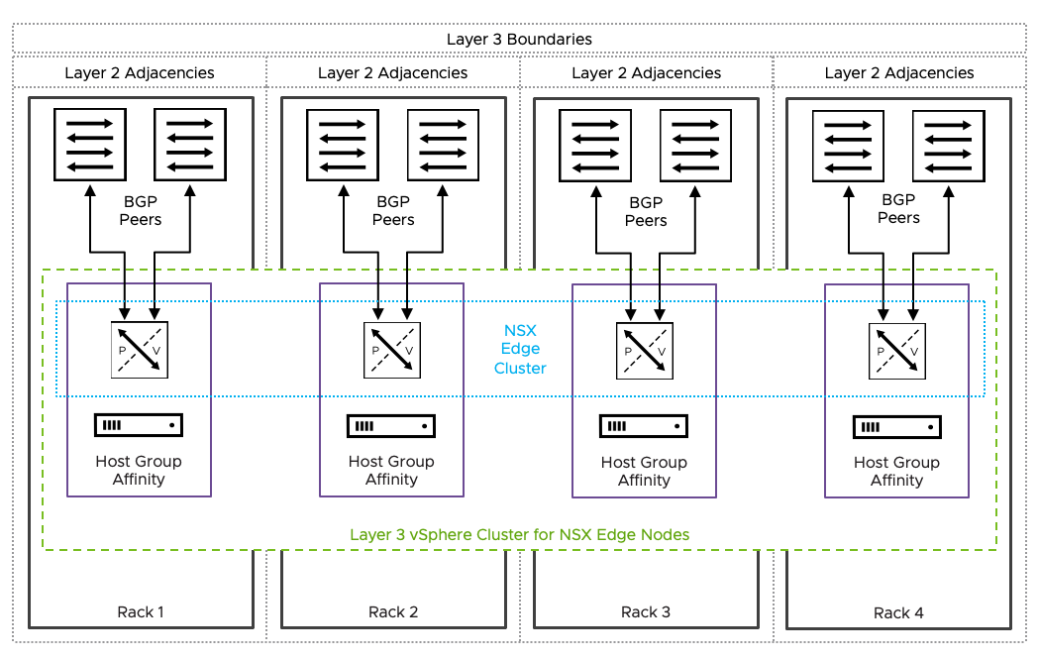
NSX Edge Cluster Architecture
Rack Fault Tolerant Design using a single Layer 3 vsphere Cluster deployed across multiple racks

Slide 37
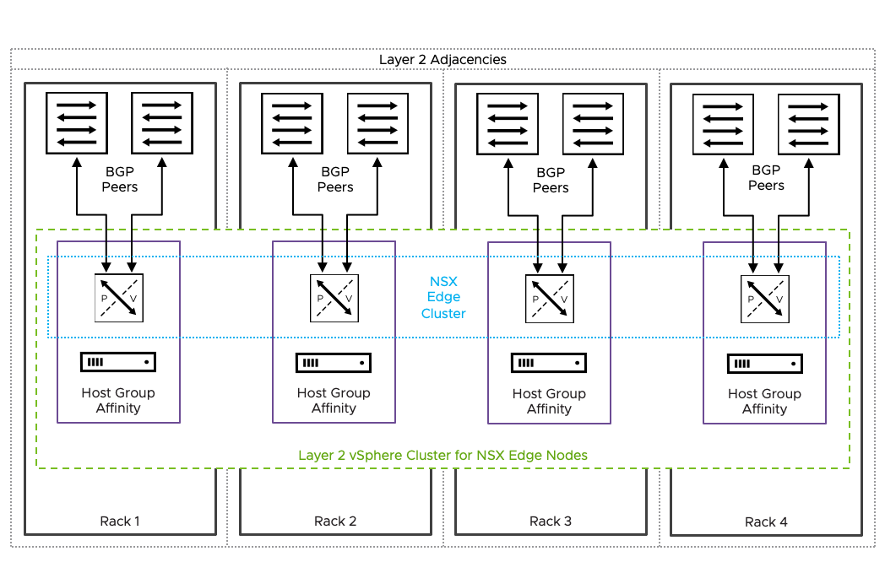
NSX Edge Cluster Architecture
Rack Fault Tolerant Design using a single Layer 2 vSphere Cluster deployed across multiple racks

Slide 38
NSX Edge Cluster Models
Dual Availability Zones

Slide 39
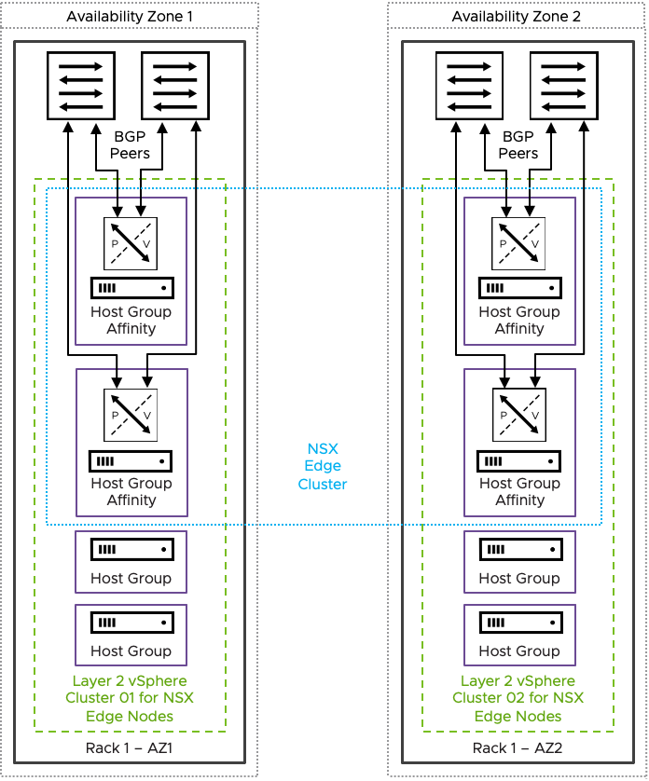
NSX Edge Cluster Architecture
Dual Availability Zone Design based on NSX Edge Node HA - Dedicated vSphere cluster

Slide 40
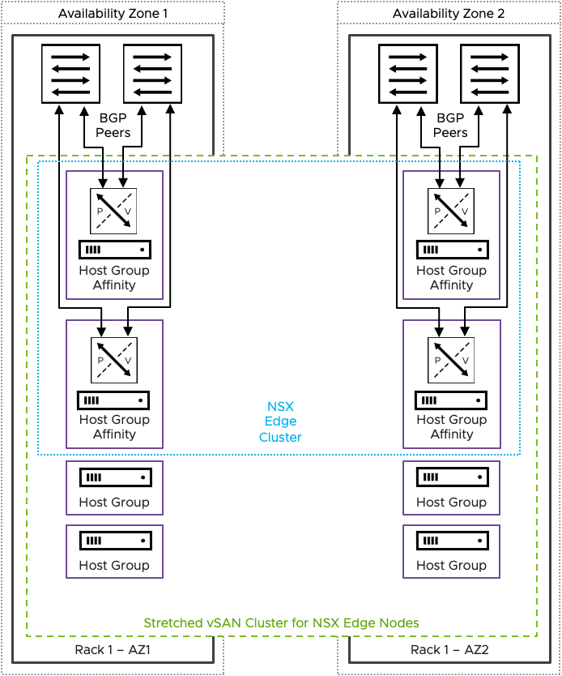
NSX Edge Cluster Architecture
Dual Availability Zone Design based on NSX Edge Node HA - stretched vSAN cluster

Slide 41
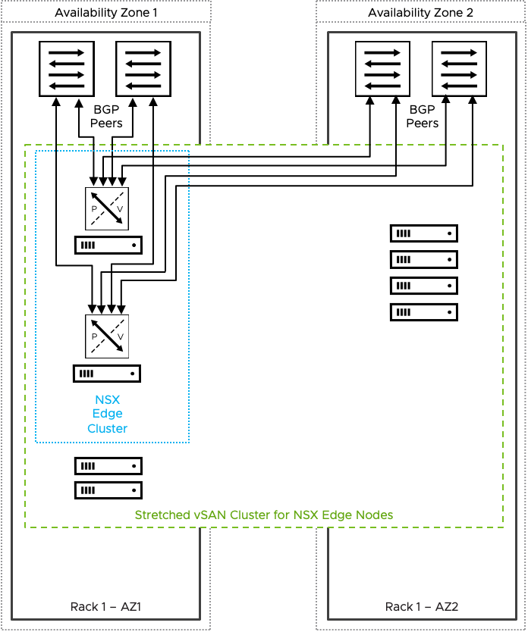
NSX Edge Cluster Architecture
Dual Availability Zone Design based on vSphere HA Recovery

Slide 42
VMware Pro Cloud Services for Private Cloud Infrastructure
VCF Automation Architecture Patterns

Slide 43
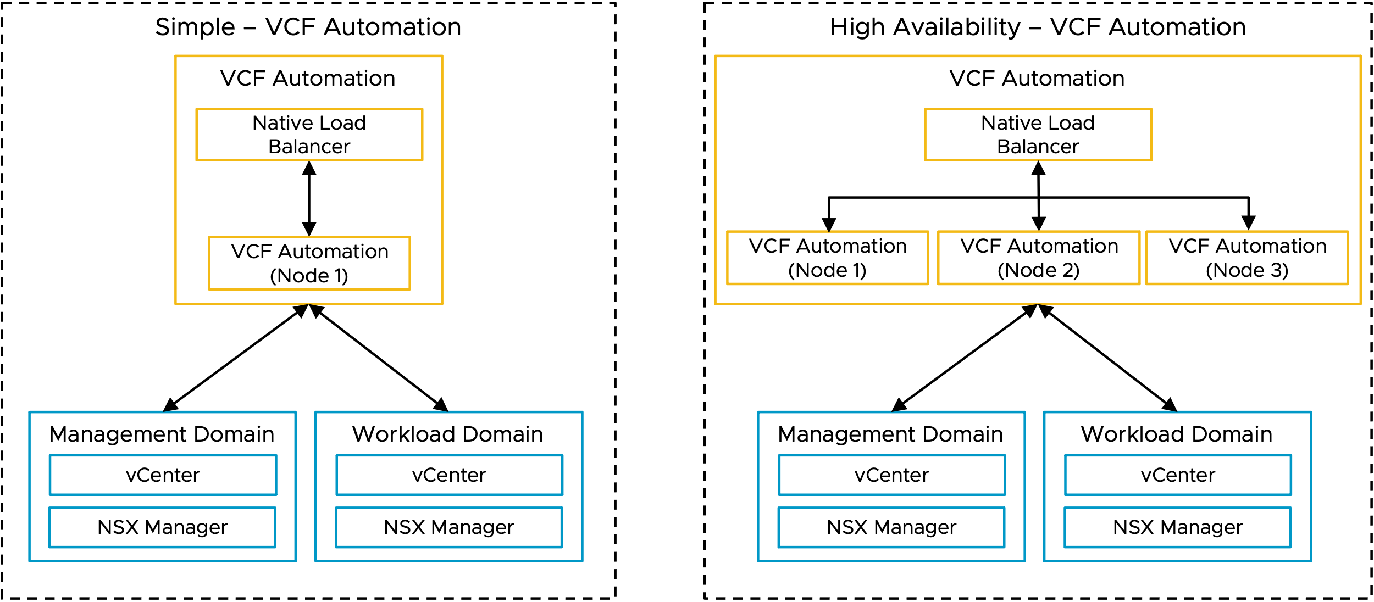
Private Cloud – VCF Automation
Logical Design

Slide 44
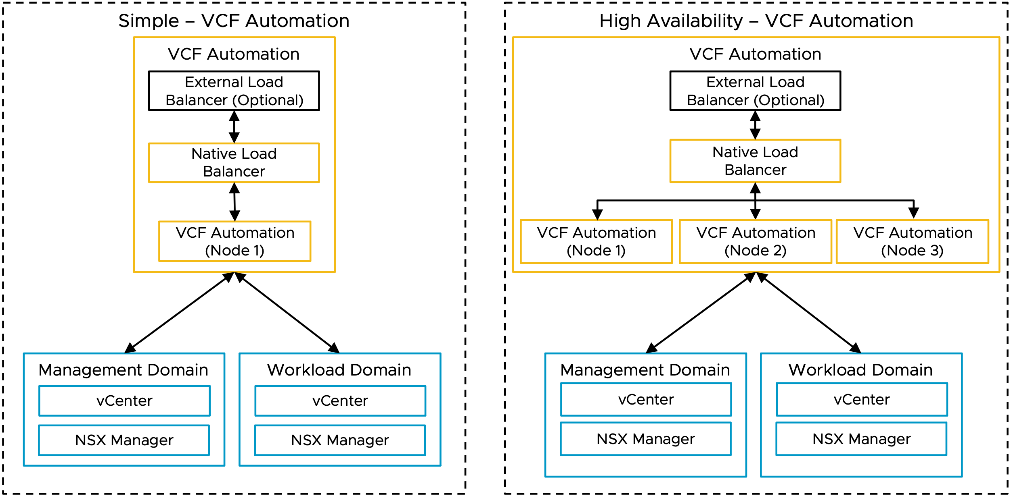
Private Cloud – VCF Automation (2)
Logical Design

Slide 45
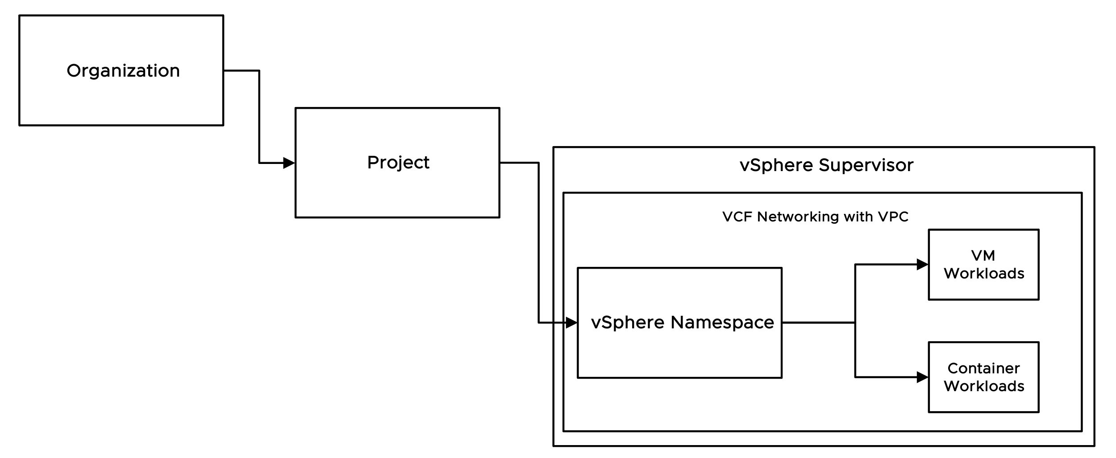
Private Cloud – VCF Automation
Organizational Construct Hierarchy Object Flow

Slide 46
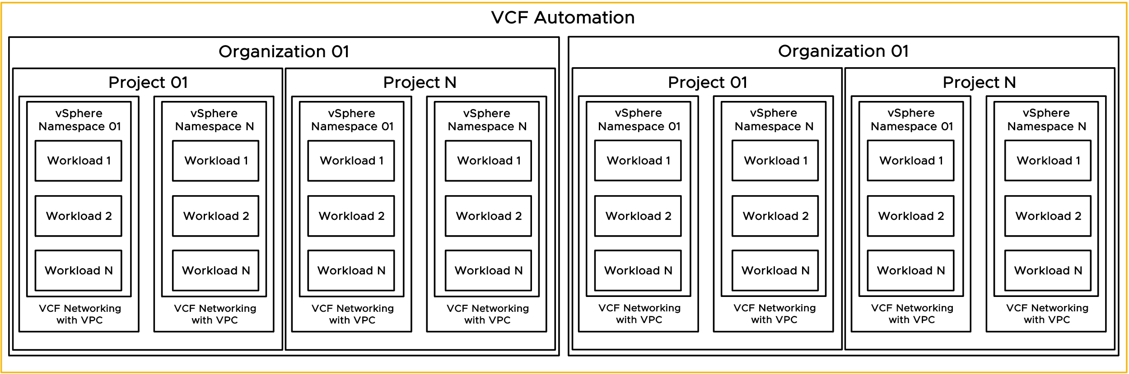
Private Cloud – VCF Automation
Org Hierarchy with VPCs

Slide 47
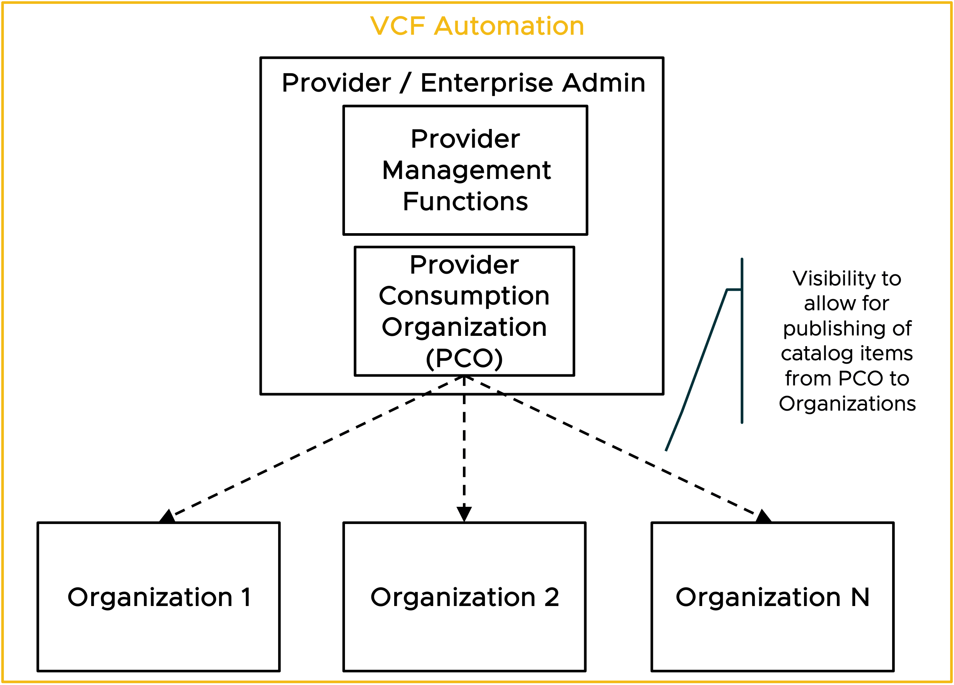
Private Cloud – VCF Automation
Provider Consumption Org Flowchart

Slide 48
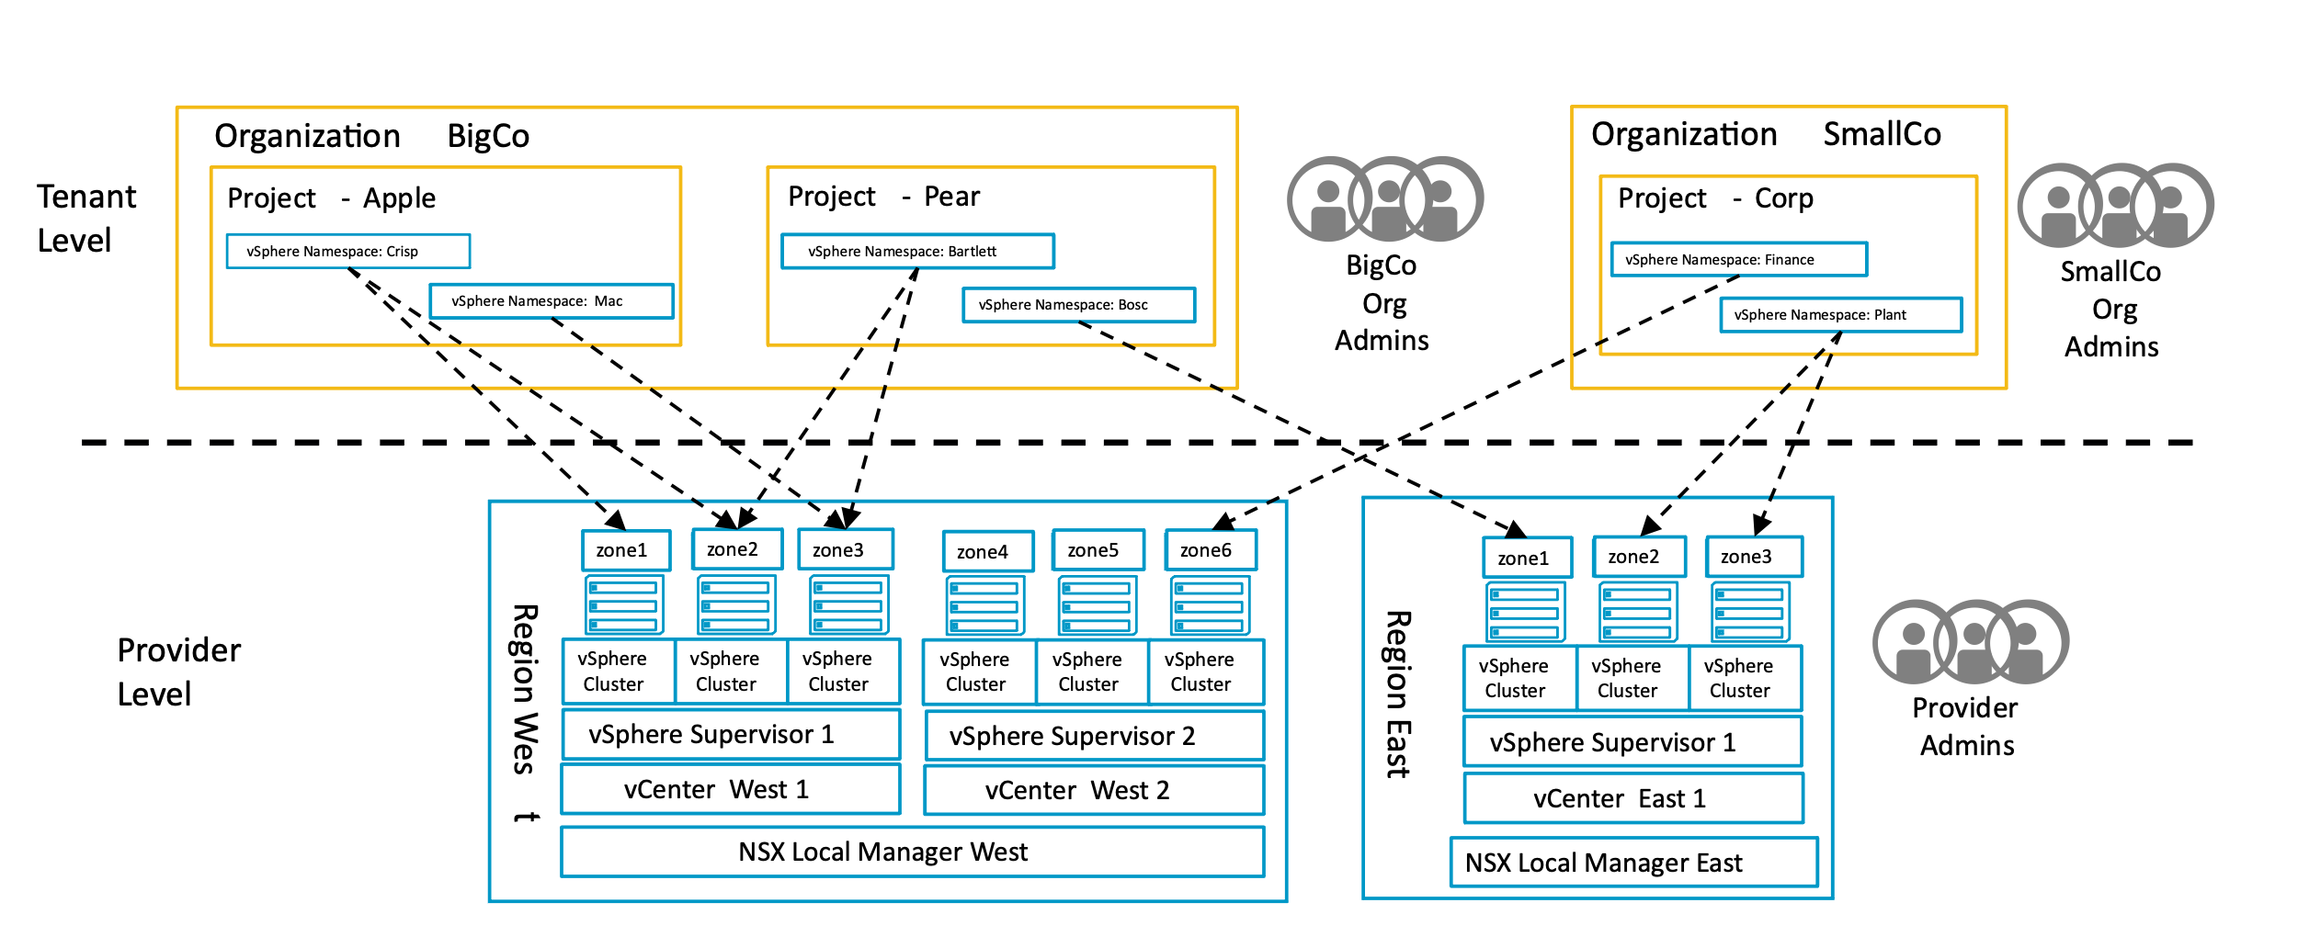
Private Cloud – VCF Automation
Example: Supervisor to Organization Relationship

Slide 49
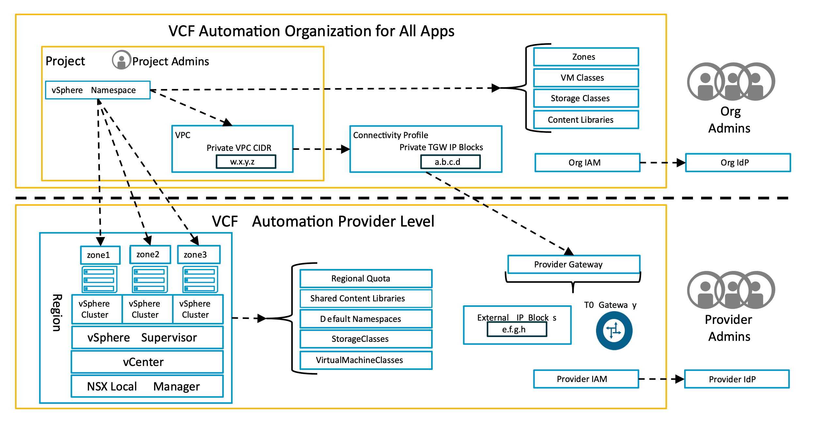
Private Cloud – VCF Automation
Org / Tennant Model

Slide 50
VMware Pro Cloud Services for Private Cloud
VCF Operations Architecture Patterns

Slide 51
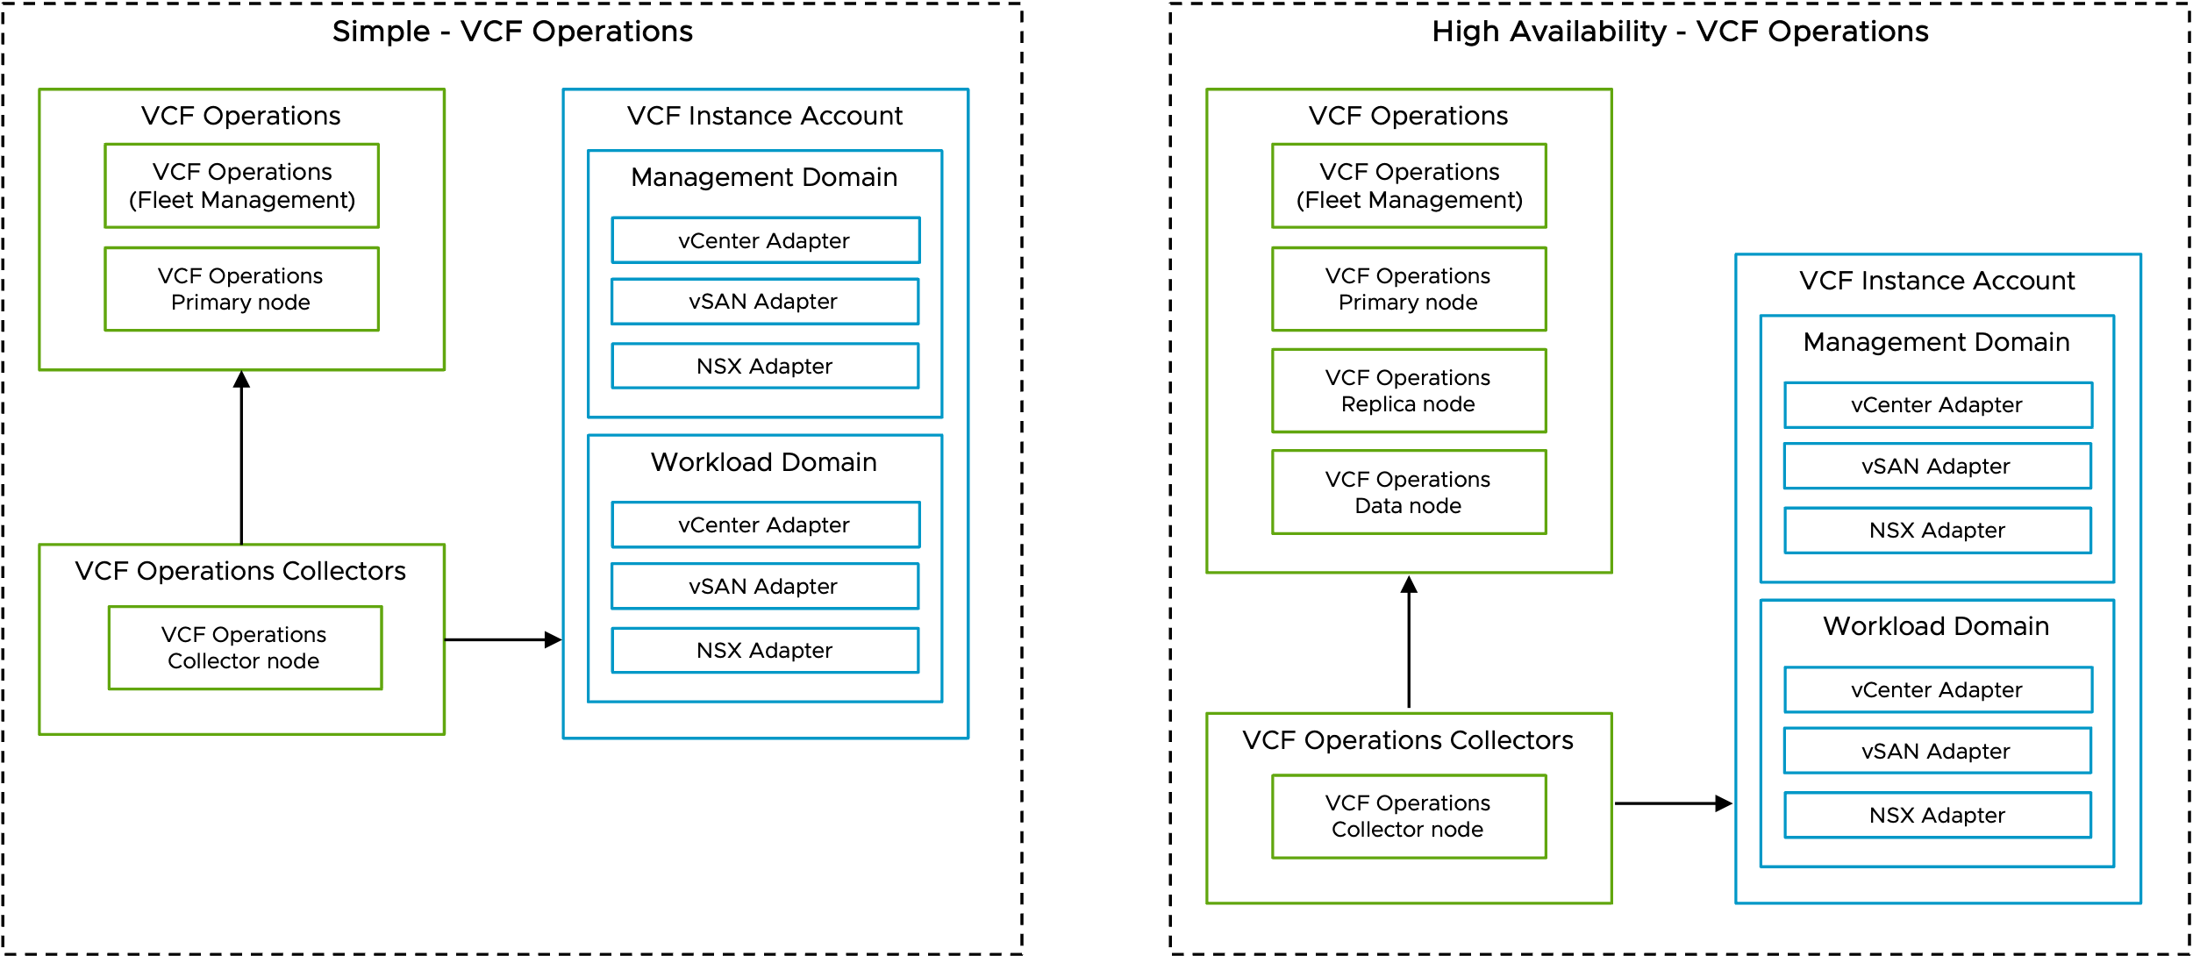
Private Cloud – VCF Operations
Logical Design

Slide 52
VMware Pro Cloud Services for Private Cloud
VCF Operations for Logs Architecture Patterns

Slide 53
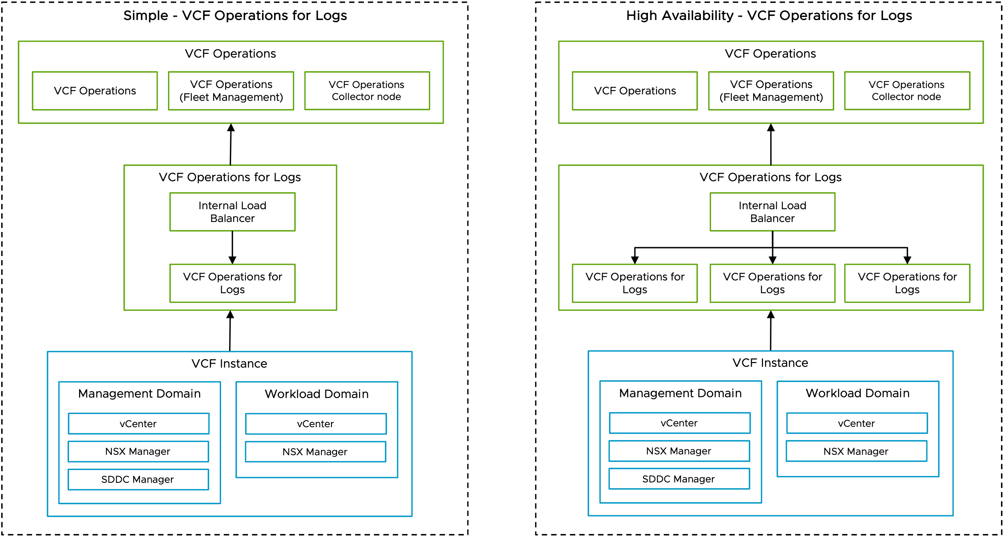
Private Cloud – VCF Operations for Logs
Logical Design

Slide 54
VMware Pro Cloud Services for Private Cloud
VCF Operations for Networks Architecture Patterns

Slide 55
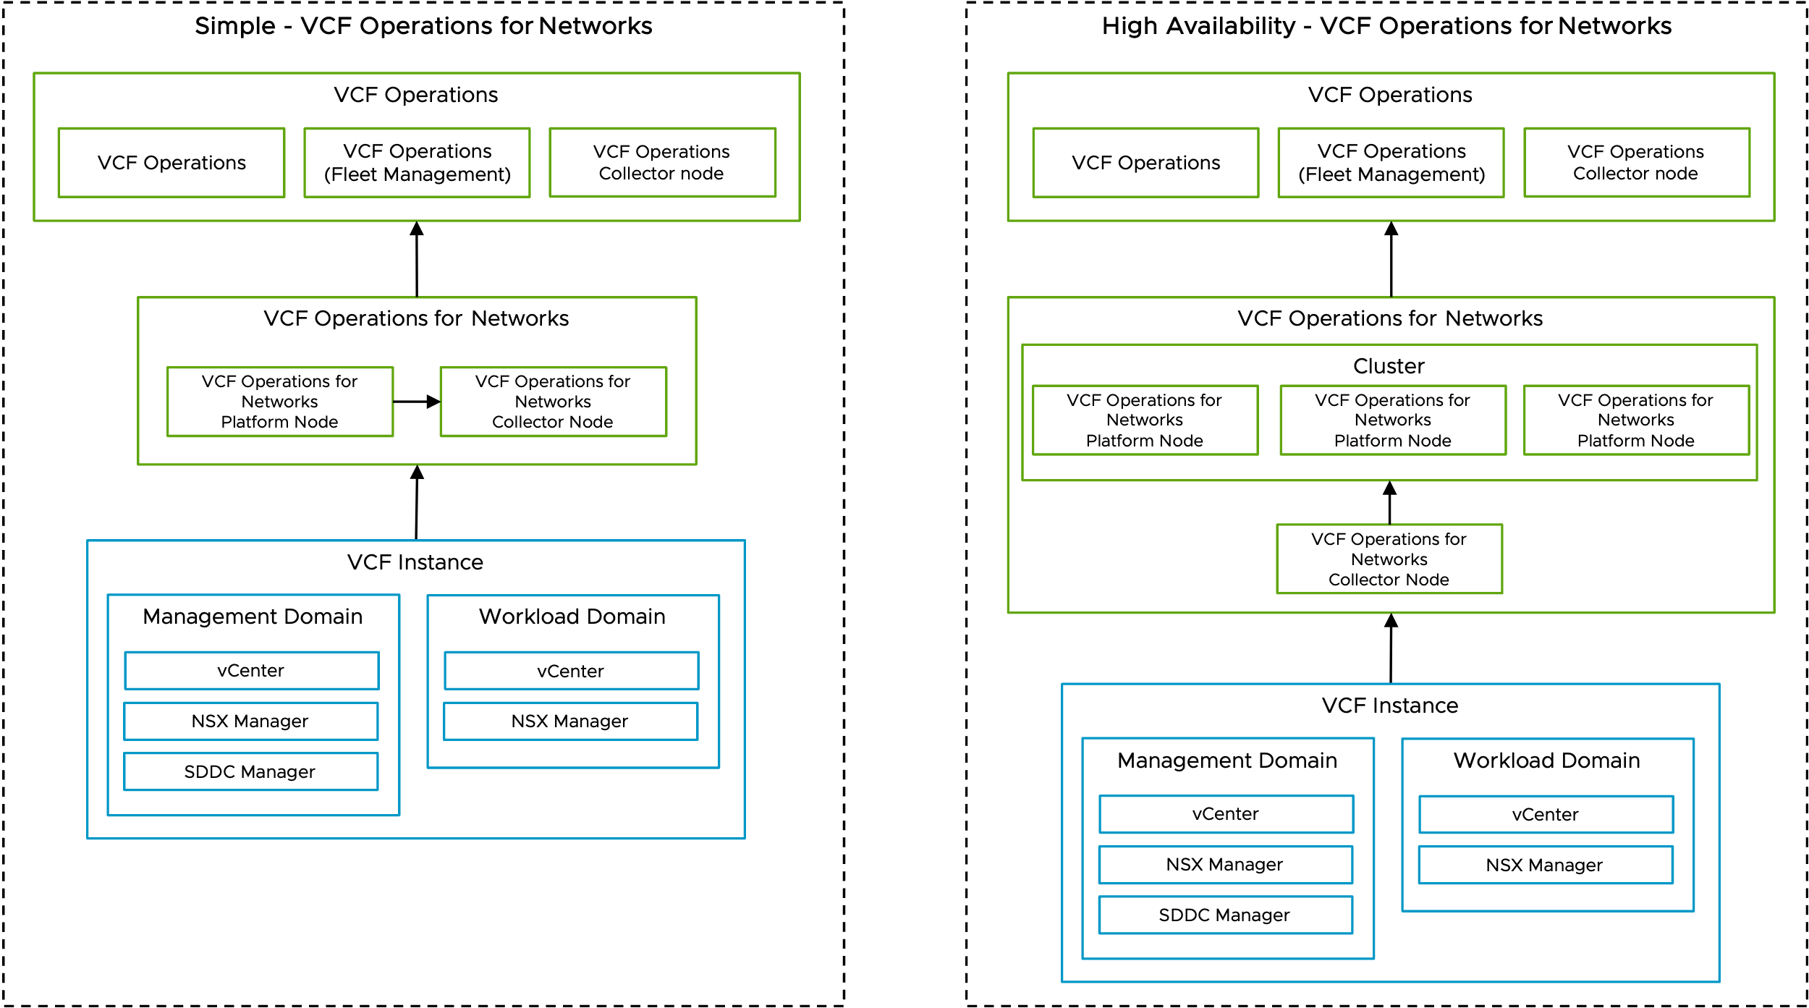
Private Cloud Infrastructure – VCF Operations for Networks
Logical Design

Slide 56
VMware Pro Cloud Services for Private Cloud
vSphere Kubernetes Service Architecture Patterns

Slide 57
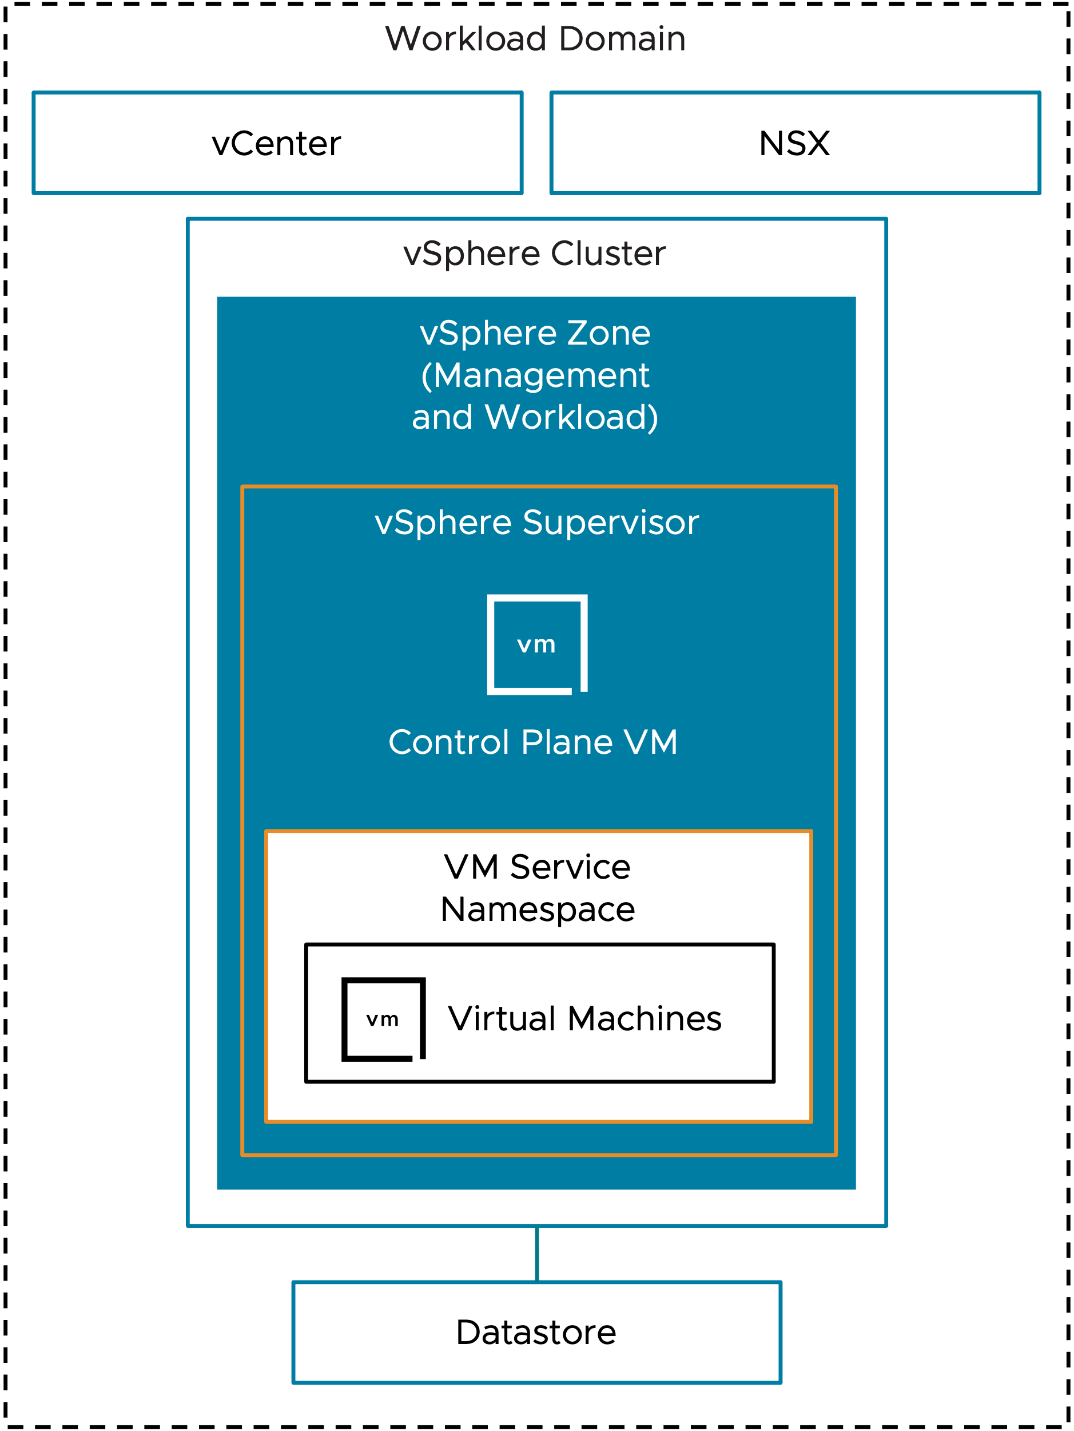
Private Cloud – vSphere Kubernetes Service
Logical Design – Simplified Supervisor

Slide 58
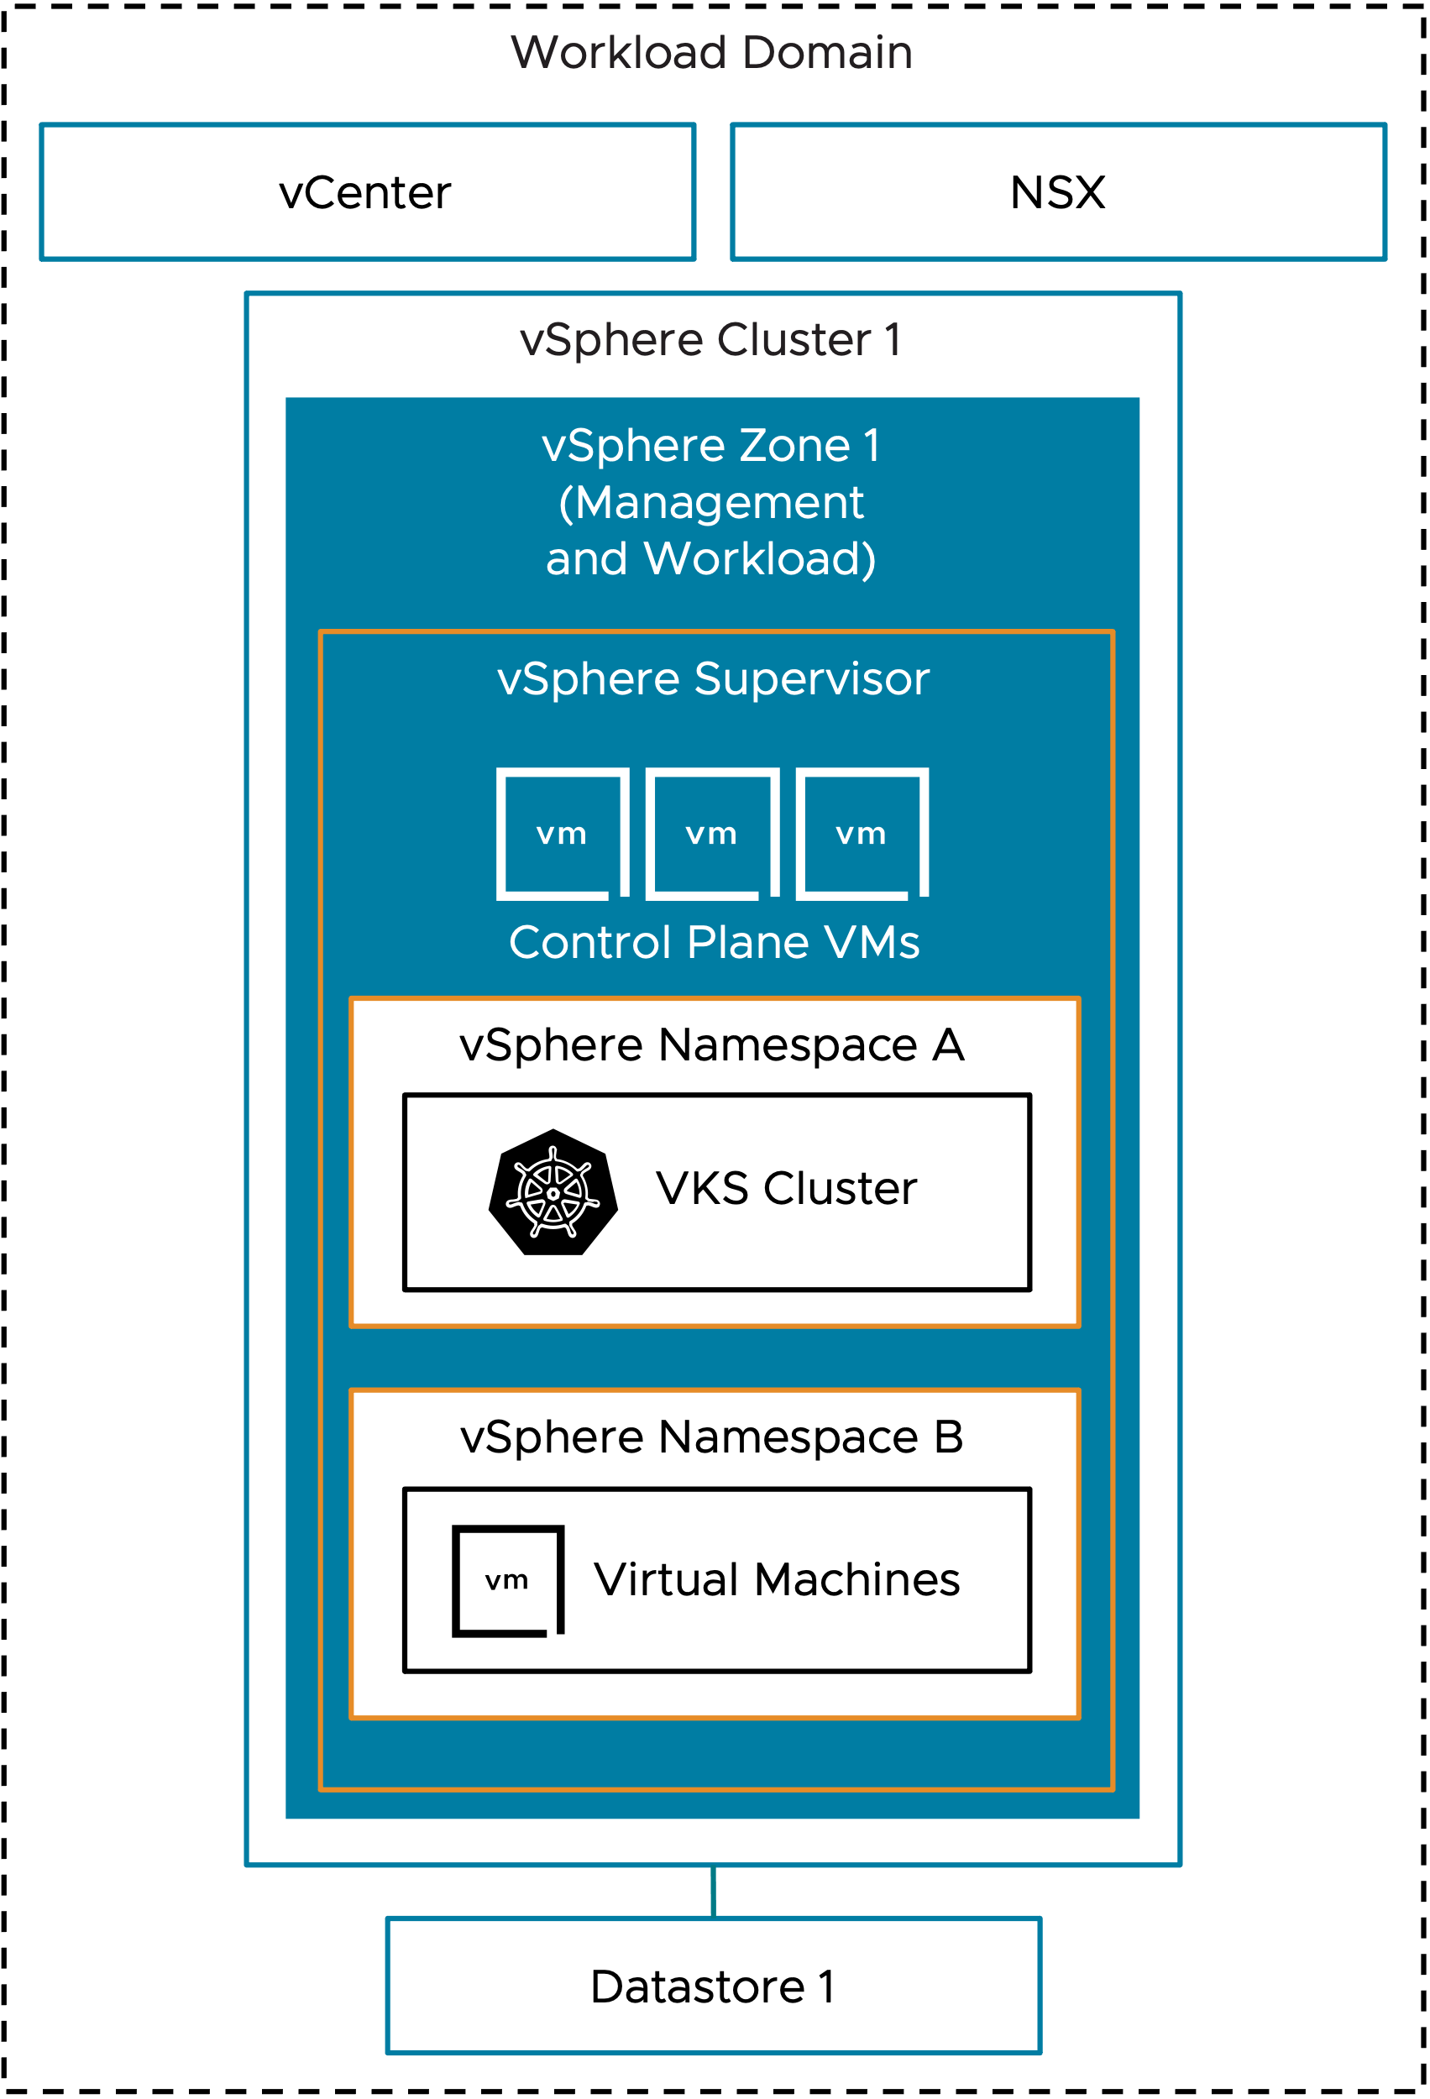
Private Cloud – vSphere Kubernetes Service
Logical Design – Single Management Zone with Combined Workload Zones Model

Slide 59
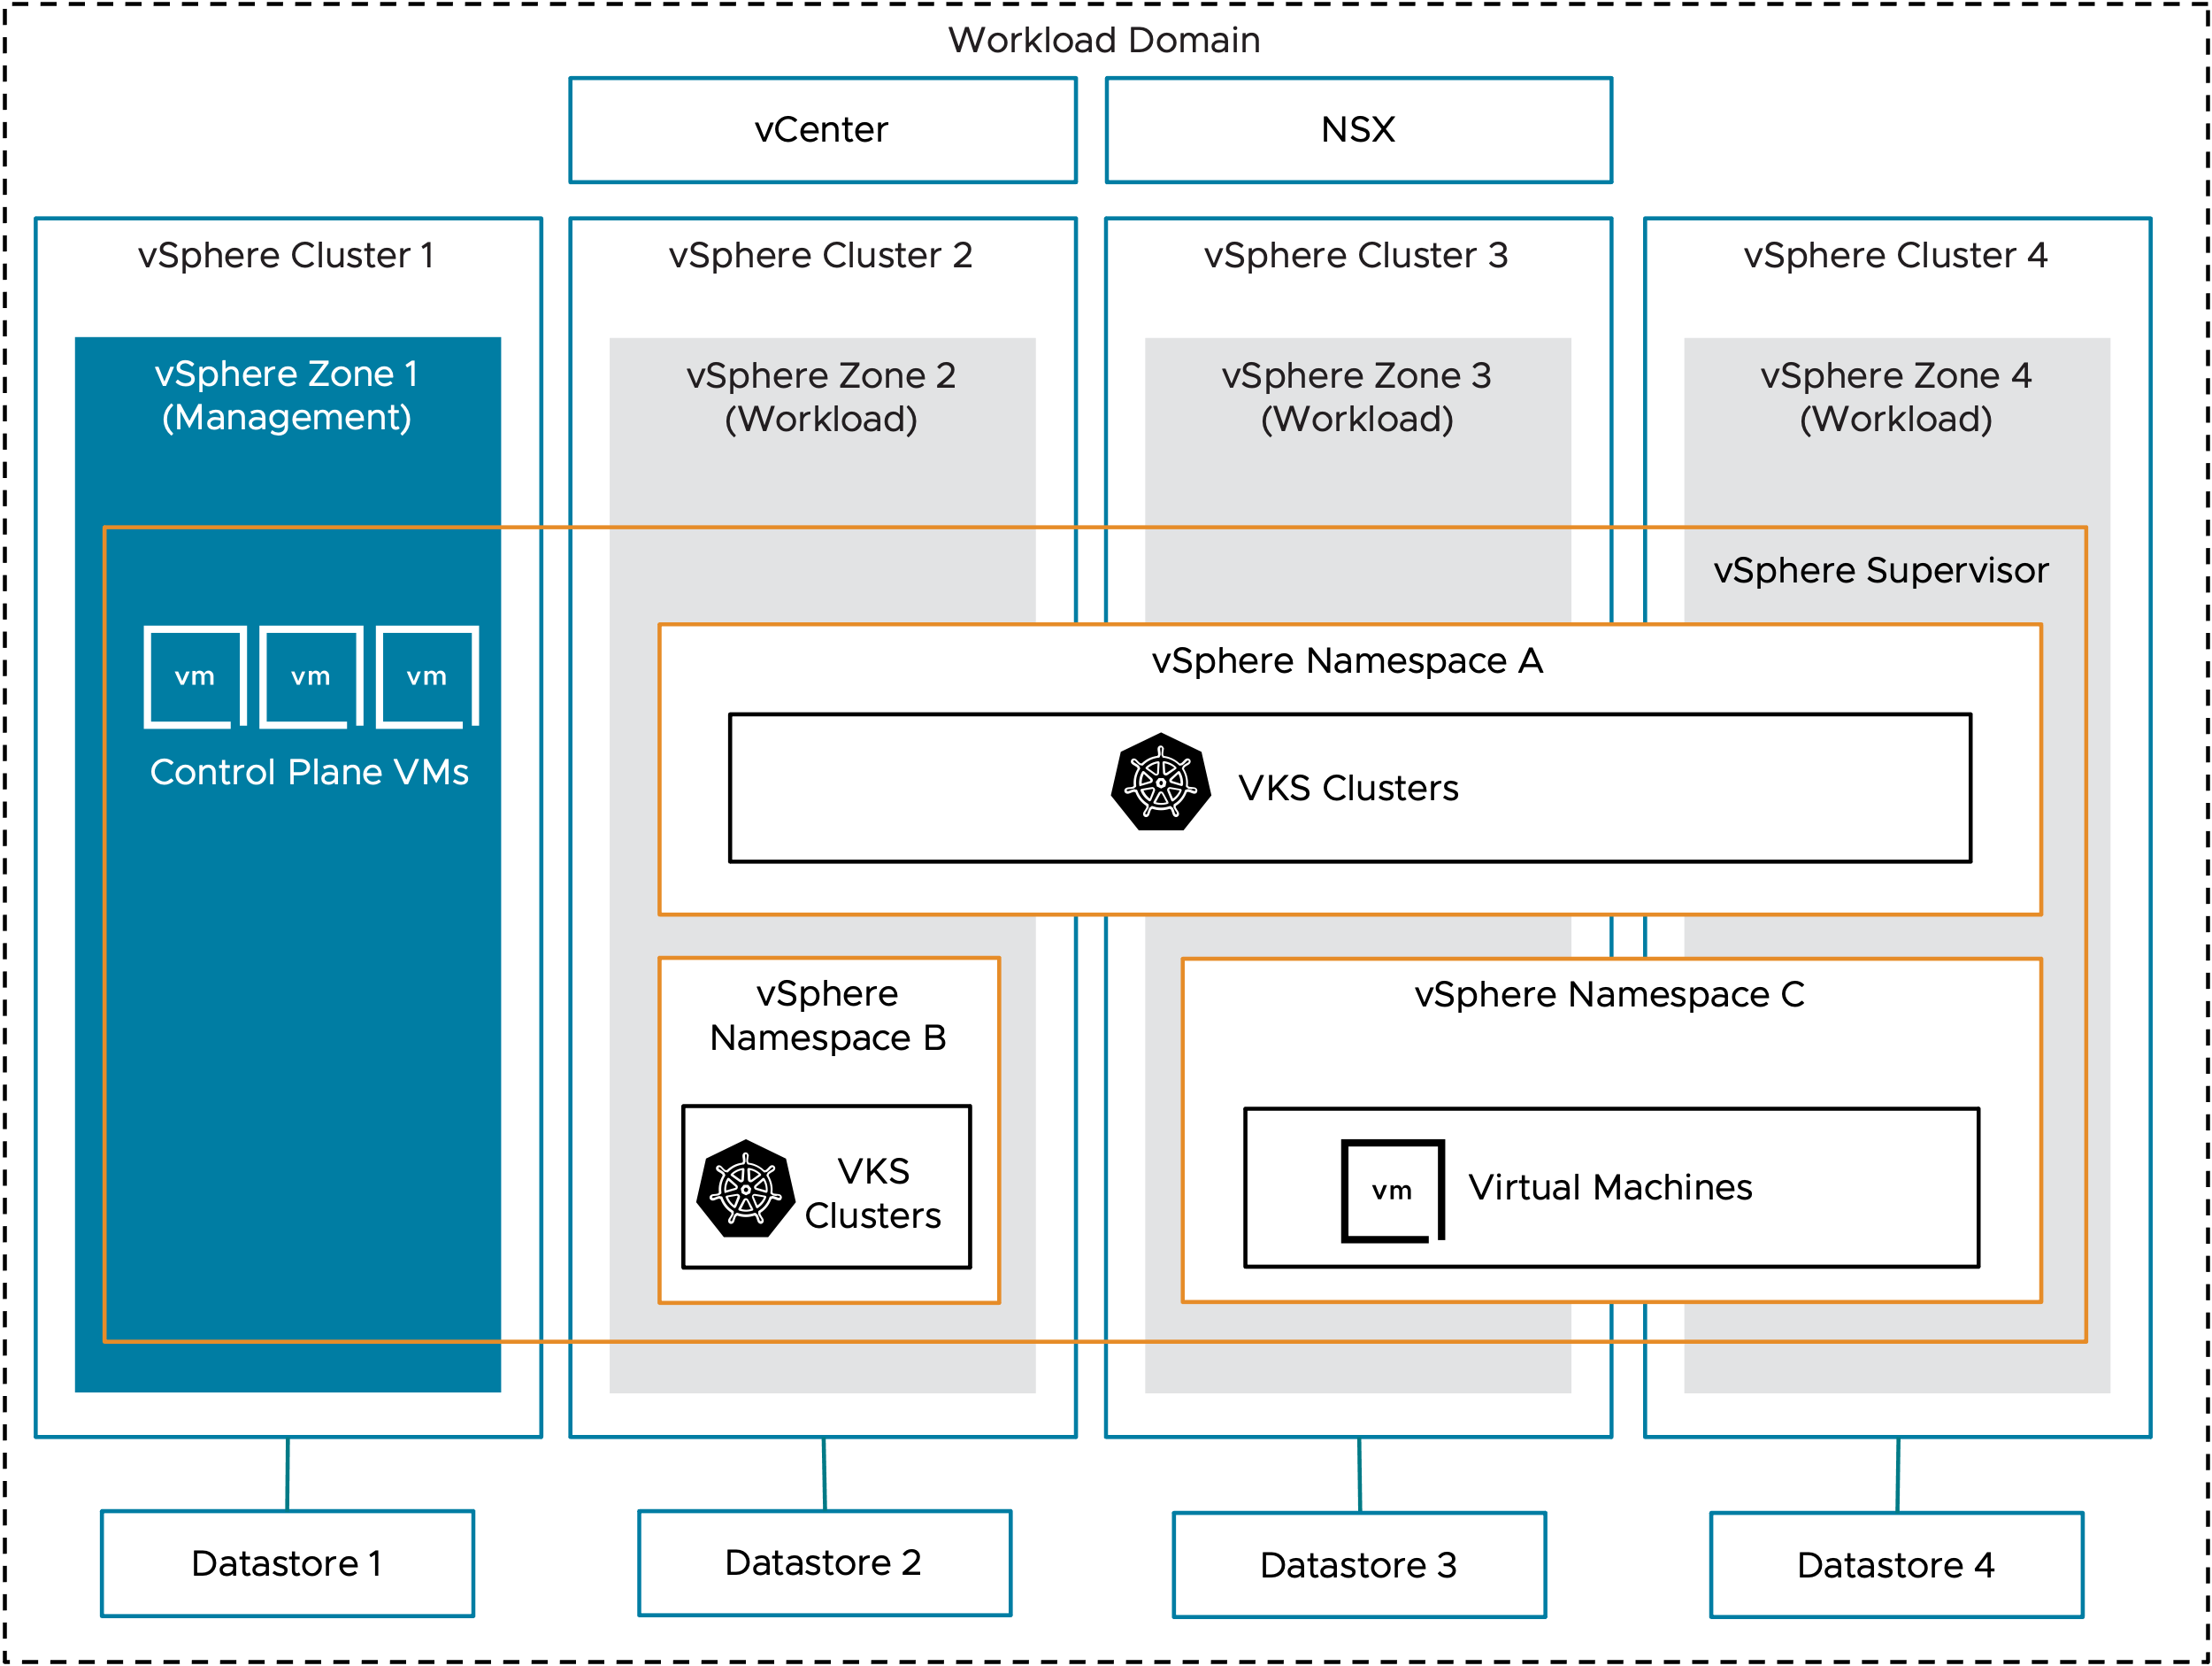
Private Cloud – vSphere Kubernetes Service
Logical Design – Single Management Zone with Isolated Workload Zones Model

Slide 60
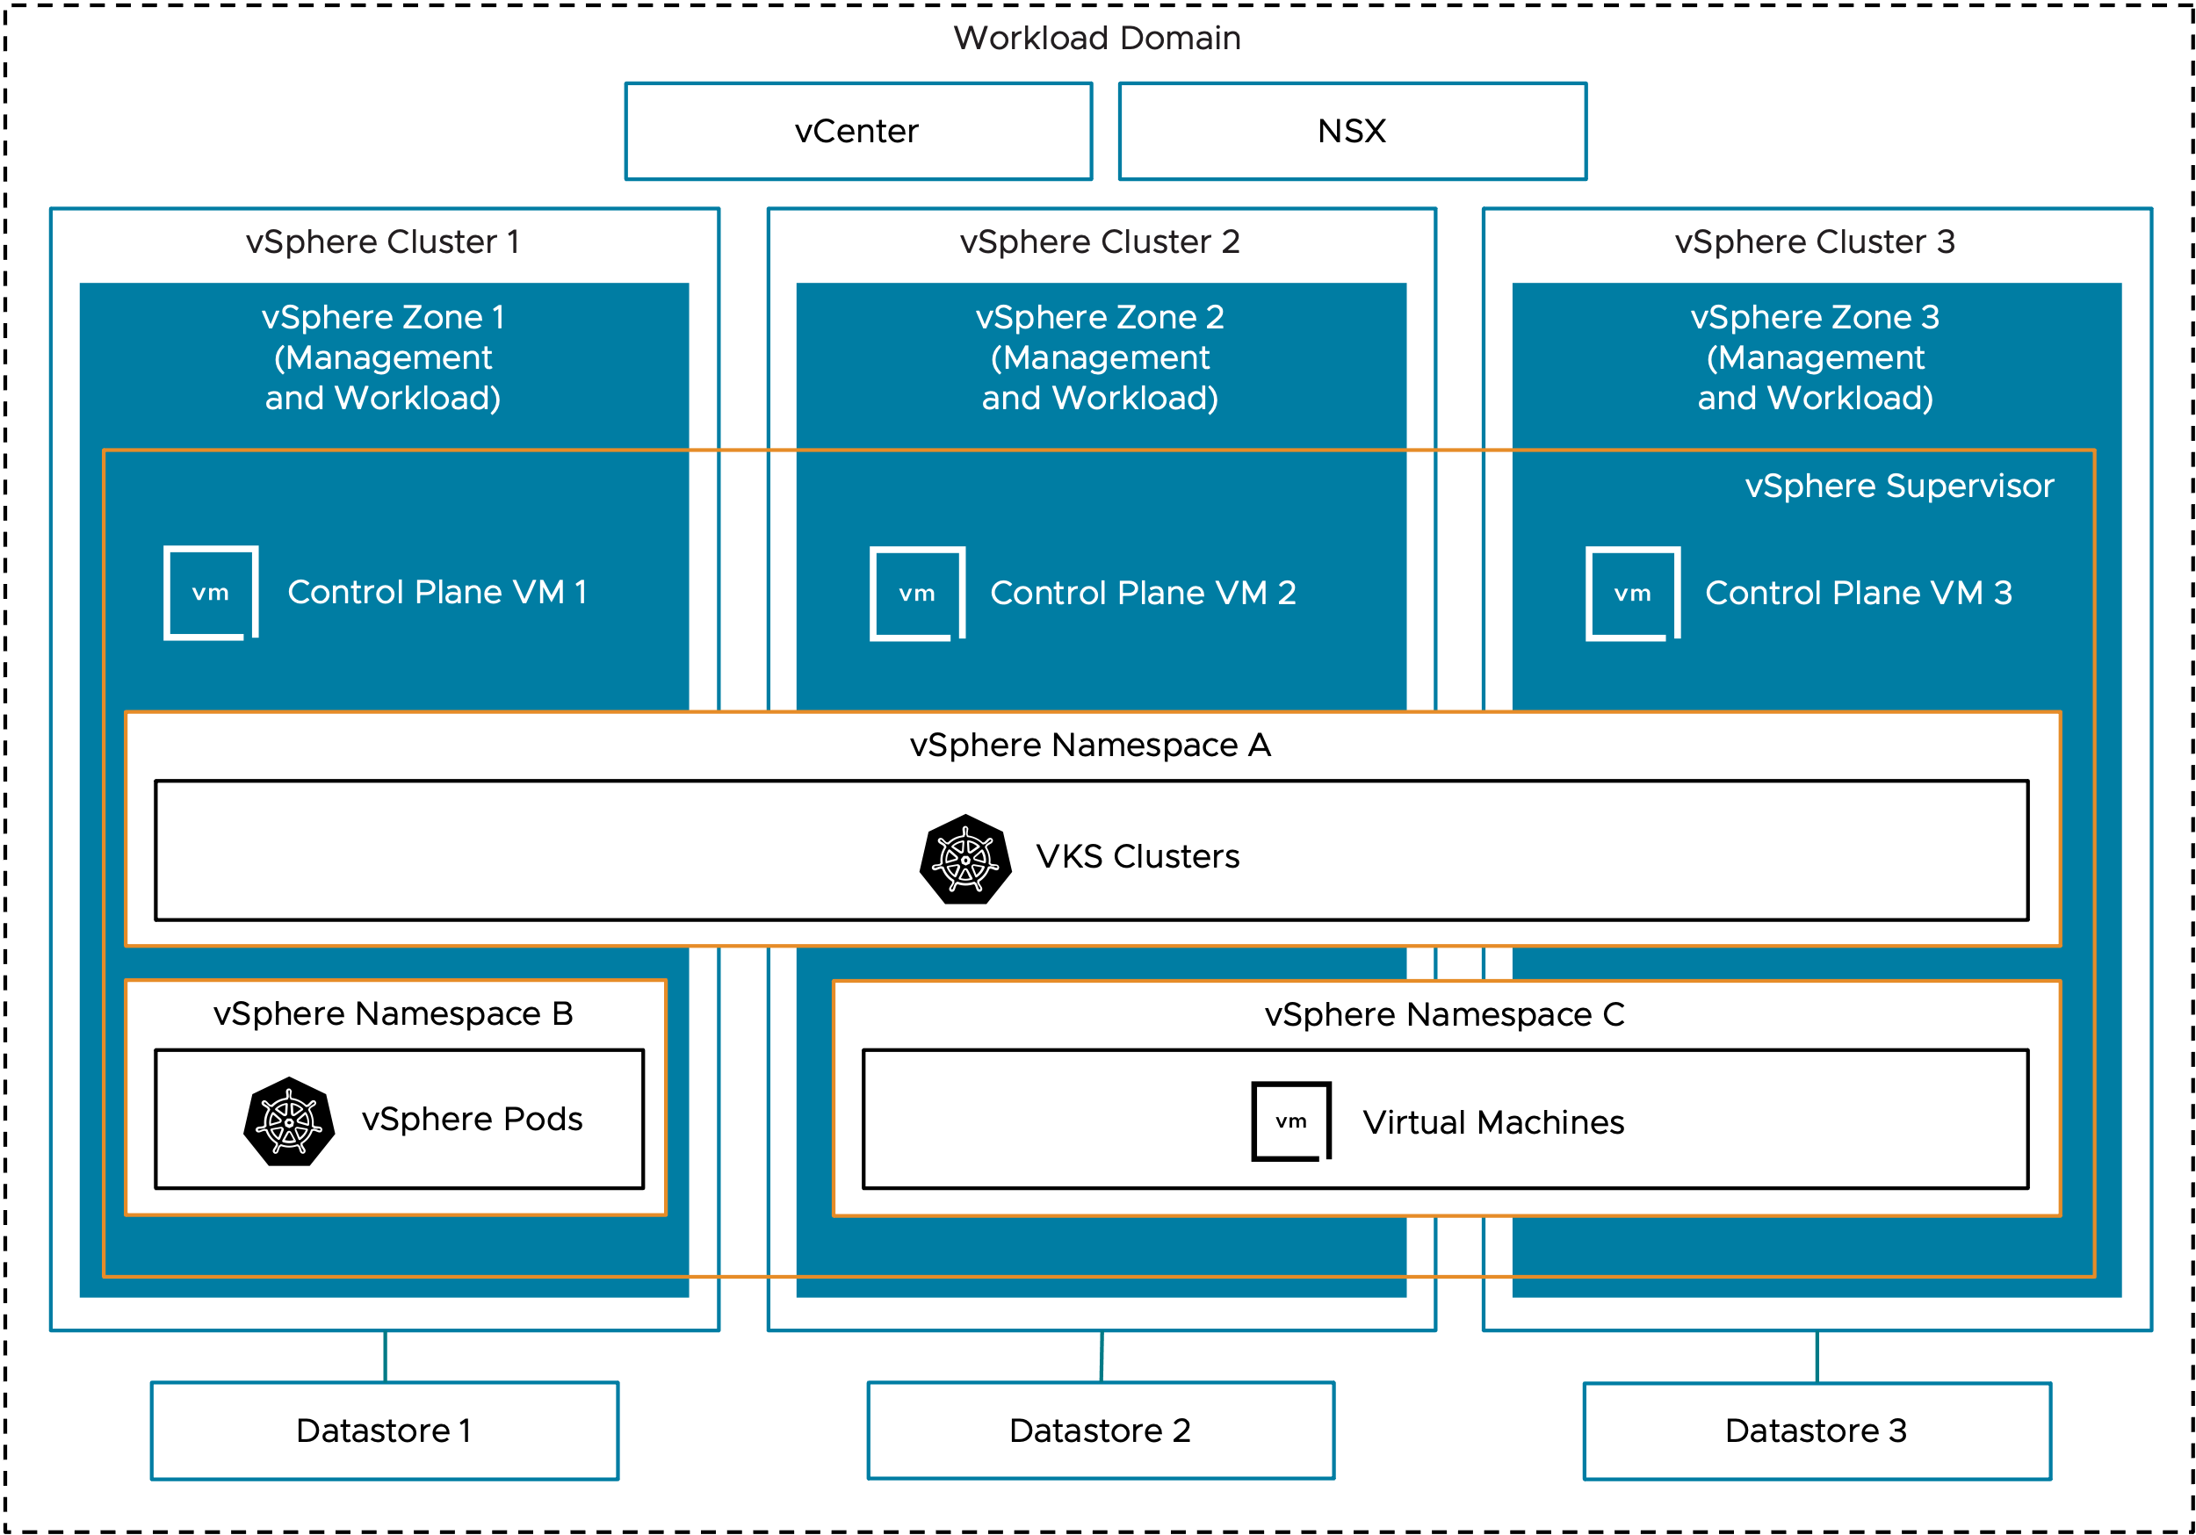
Private Cloud – vSphere Kubernetes Service
Logical Design – Three Management Zones with Combined Workload Zones Model

Slide 61
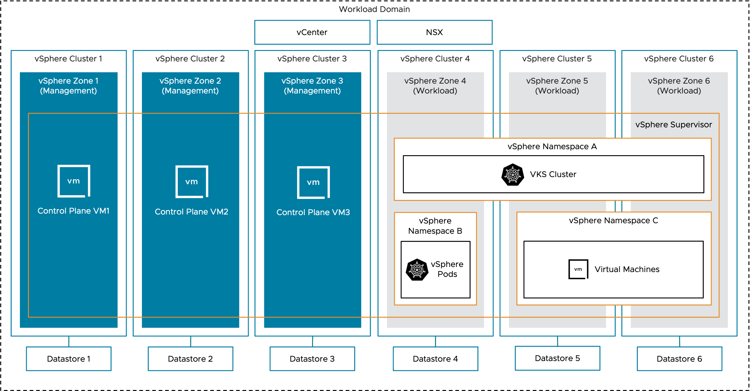
Private Cloud – vSphere Kubernetes Service
Logical Design – Three Management Zones with Isolated Workload Zones Model

Slide 62
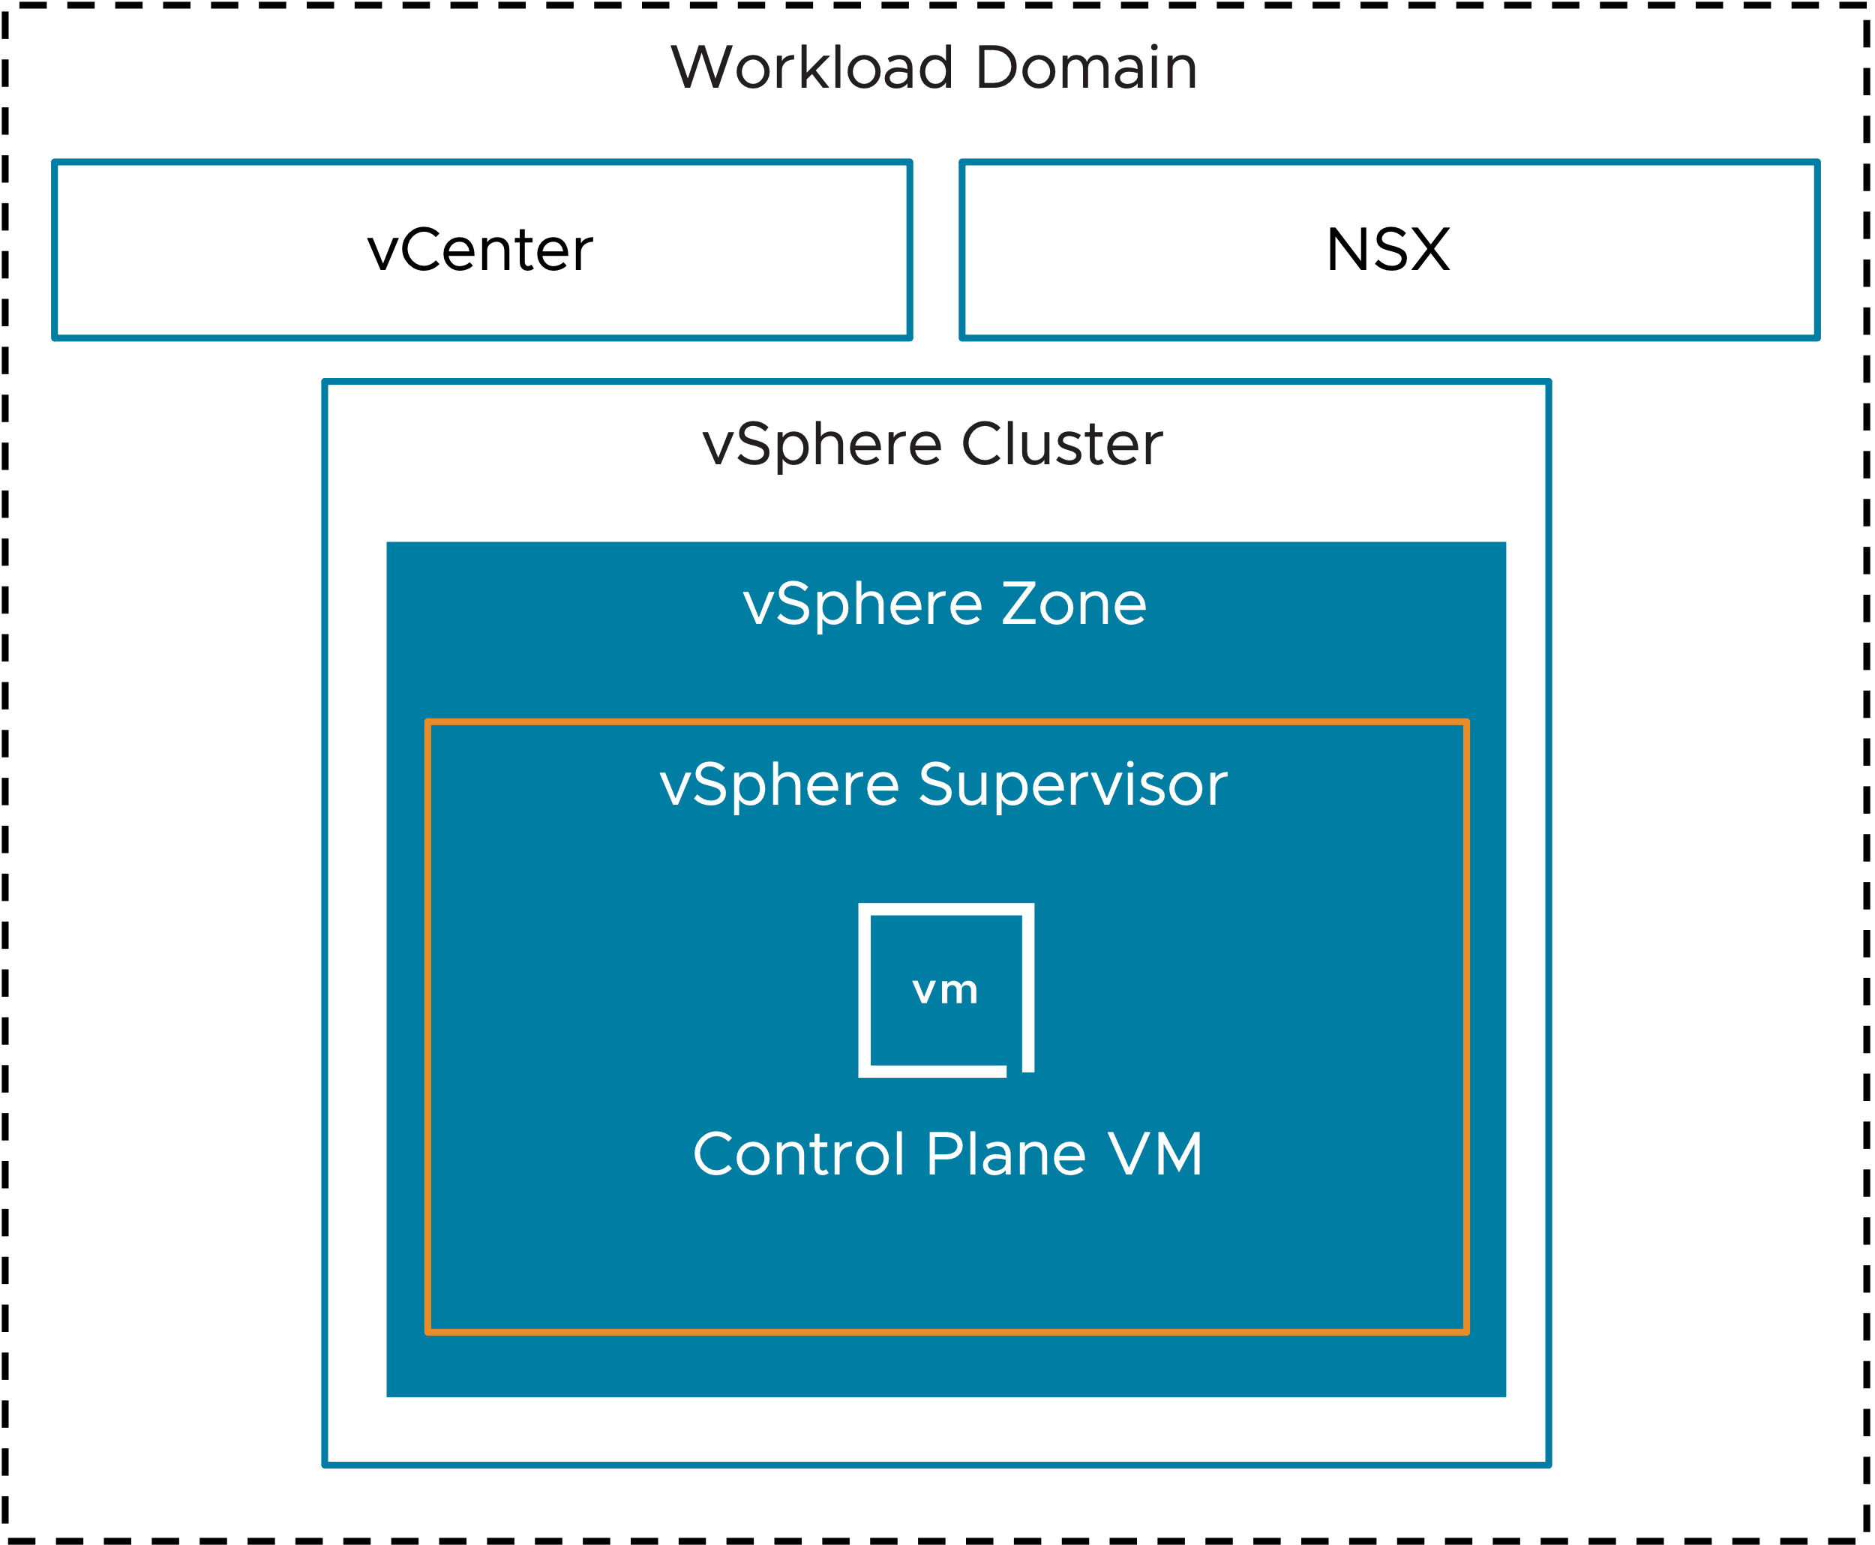
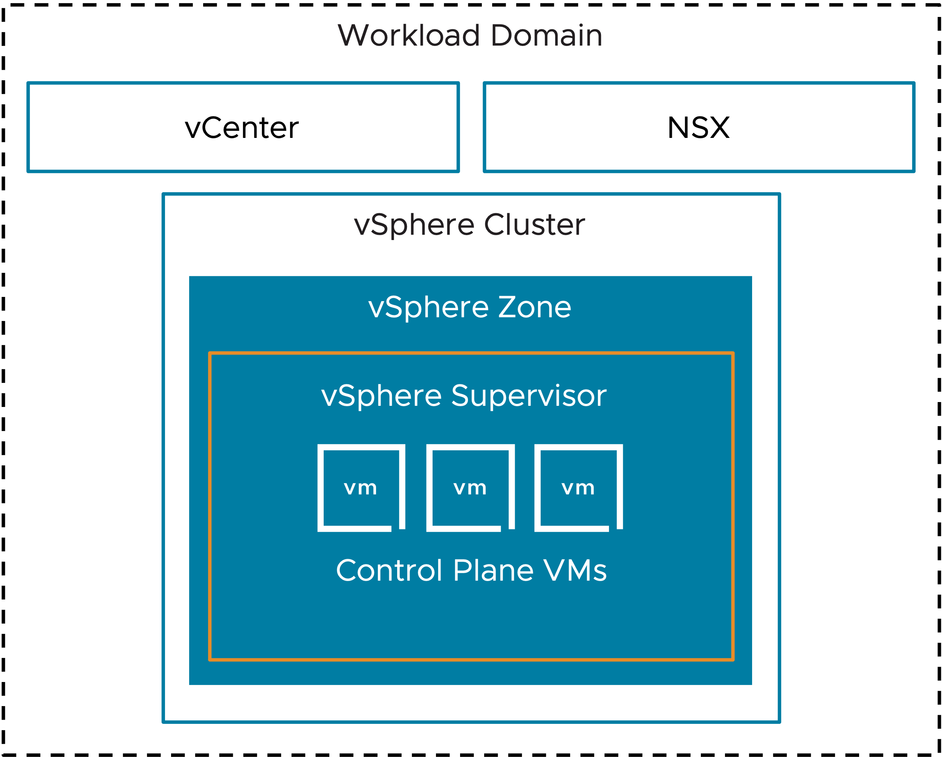
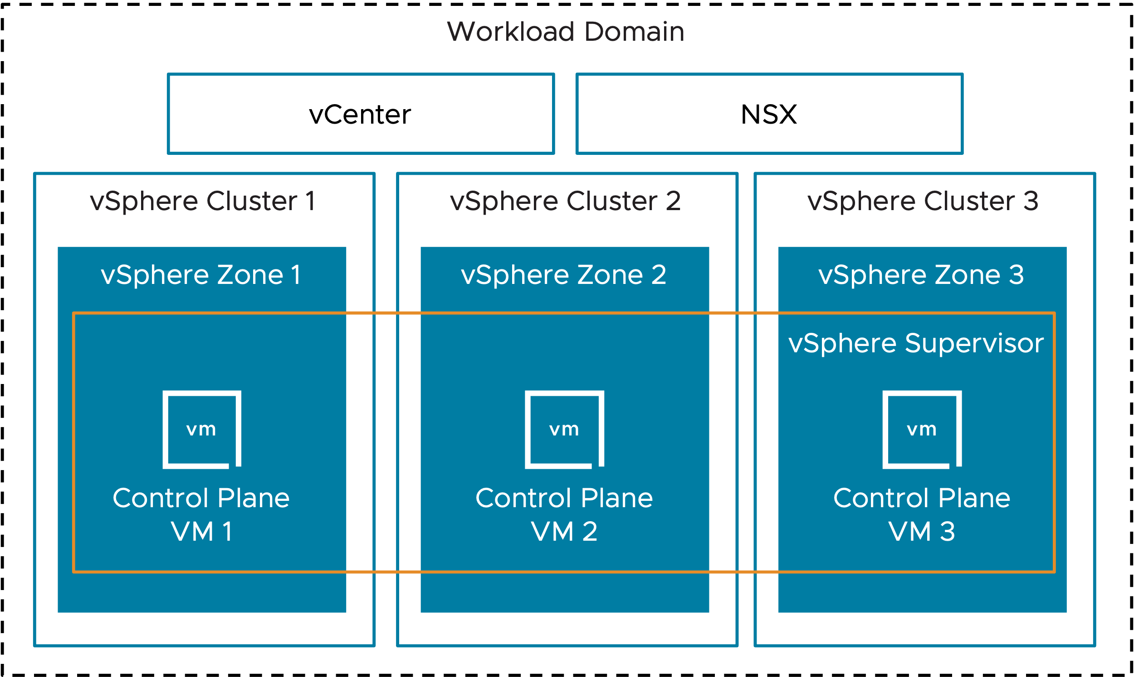
Private Cloud – vSphere Kubernetes Service
Control Plane Logical Design
Simple
Single Management Zone
Three Management Zones

Slide 63
VMware Pro Cloud Services for Private Cloud
Security Architecture Pattern

Slide 64
Philosophy & Approach
VMware Cloud Foundation 9.0
Notes:
Talk Track:
Let’s look at some of what’s new in VMware Cloud Foundation 9.0.
Notes:
N/A
References:
https://brcm.tech/vcf-security, https://sales-resources.broadcom.com/group/vcf/security-compliance

Slide 65
Security in Cloud Foundation
Be Secure, Faster
All the capabilities you need to succeed, turned on and ready to use, flexible to meet any workload or environment’s needs.
Inherent Trust
Visibility into, and control of, the entire infrastructure stack is very important. Replace trust with continuous verification.
Recover Quickly
Resilience has always been the primary feature of VMware infrastructure products, whether you face a failed application upgrade or a natural disaster.
Notes:
Key Message:
Understand the three main goals of VCF security that make us different (and better) than the public cloud and other on-premises vendors.
Talk Track:
***ANIMATED***
When we think about cloud infrastructure security there are three main goals we are trying to achieve. First, we want you to be secure quickly, and stay that way. We provide all the capabilities you will need and turn them on by default, but also remain flexible to meet the needs of any workload. No security or compliance effort ever survives contact with real workloads, especially older ones, and having flexibility to meet their needs in a bespoke, tailored fashion is important. One size does not fit all with security.
**CLICK** The second thing we strive for is to drive trust in your infrastructure. And actually, one of the ways to do that is to replace trust with verification and validation, so that you know what the state of your environment is at any given time. You don’t have to take someone else’s word for it, because you control the situation from the ground up.
**CLICK** Third thing is to enable you to be resilient, easily. Resilience has been the primary feature of VMware products since 2005 when vMotion first shipped, and it’s finally getting attention with some of the new compliance standards, like DORA and NIS2. Being resilient to small problems, big problems, ransomware, hurricanes, system failures, disk failures, human error, and more is important, and with VCF you are well-equipped to deal with all of those situations.
Notes:
This is important to understand our approach to security. This space is large and talking about specific features can take days, so we approach it from the high level and drill in.
References:
https://brcm.tech/vcf-security, https://sales-resources.broadcom.com/group/vcf/security-compliance

Slide 66
CIA Triad: Core Tenets of Information Security
Confidentiality
Protecting systems & data from unauthorized people & groups
Integrity
Preventing modification of data by unauthorized groups & systems
Availability
Ensuring that data is available to authorized parties when needed
Notes:
Key Message:
Understand the three main pillars of information security as a foundation for our approach to security.
Talk Track:
One of the other ways we think about security in VCF is through the core tenets to information security, known as the CIA Triad.
Confidentiality means that unauthorized people don’t have access to your data. This is traditionally what people consider security, but there’s actually two other pillars that are really important, too…
…like integrity. Integrity means that our data doesn’t change on us, like if an attacker is able to deposit malware on systems. It also means that we have protections from things that aren’t an attack, per se, like a failing storage device which corrupts data while it fails.
Last is availability. If our data isn’t available to us when we need it, what’s the point of these systems? Availability problems can come from things like ransomware, or even from day-to-day work going on, and we can
Notes:
This is important to understand our approach to security. Many IT practitioners do not actually think in this way, and a short overview is helpful as a foundation for both security and compliance.
References:
https://brcm.tech/vcf-security, https://sales-resources.broadcom.com/group/vcf/security-compliance

Slide 67

Confidentiality
VM Encryption
Virtualization-Based Security
Intel vSGX
CPU Vulnerability Mitigations
AMD SEV-ES
Identity Federation
vSAN Transport Encryption
Distributed Switch Security
Every Feature is a Security Feature
Native Key Provider
FIPS 140-3
vSAN Encryption
Encrypted Configuration
TLS 1.3 & Certificates
Encrypted vMotion
NSX/ vDefend
DRS
Secure Boot
TPM & vTPM
Network Health Check
NTP & PTP
Lifecycle Manager
SIOC
vSAN Stretched Clusters
Code Signing
Live Recovery
Snapshots
Fault Tolerance
vCenter HA
EVC
Host Attestation
Skyline Health
VM Sandbox
vMotion
NIOC
Aria Operations
Integrity
Audit Logging
High Availability
HCX
Availability
NIAP/CC Certification
Storage vMotion
Cross vCenter vMotion
Configuration Profiles
Notes:
Key Message:
Understand how the three main pillars of information security inform the VCF feature set itself.
Talk Track:
***ANIMATED***
Seen through the lenses of the CIA triad, every feature in Cloud Foundation can be mapped to one or more of those pillars.
**CLICK** This certainly isn’t a complete list of features, but you get the idea here – every feature is, in some way, a security feature, and even more importantly…
Notes:
Not a complete list of features and functionality. Wouldn’t fit on the slide.
References:
https://brcm.tech/vcf-security, https://sales-resources.broadcom.com/group/vcf/security-compliance

Slide 68
Confidentiality
VM Encryption
Virtualization-Based Security
Intel vSGX
CPU Vulnerability Mitigations
AMD SEV-ES
Identity Federation
vSAN Transport Encryption
Distributed Switch Security
Security is an Inherent Property of VCF
Native Key Provider
FIPS 140-3
vSAN Encryption
Encrypted Configuration
TLS 1.3 & Certificates
Encrypted vMotion
NSX/ vDefend
DRS
Secure Boot
TPM & vTPM
Network Health Check
NTP & PTP
Lifecycle Manager
SIOC
vSAN Stretched Clusters
Code Signing
Live Recovery
Snapshots
Fault Tolerance
vCenter HA
EVC
Host Attestation
Skyline Health
VM Sandbox
vMotion
NIOC
Aria Operations
Integrity
Audit Logging
High Availability
HCX
Availability
NIAP/CC Certification
Storage vMotion
Cross vCenter vMotion
Configuration Profiles
Notes:
Key Message:
Understand how the three main pillars of information security inform the VCF feature set itself.
Talk Track:
Put another way, security is an inherent property of Cloud Foundation. It’s baked in and not bolted on after the fact.
Notes:
Not a complete list of features and functionality. Wouldn’t fit on the slide.
References:
https://brcm.tech/vcf-security, https://sales-resources.broadcom.com/group/vcf/security-compliance

Slide 69
Security at Every Layer of Cloud Foundation
CLOUD FOUNDATION
LIFECYCLE
ENFORCEMENT
MONITORING
THREAT DETECTION
RECOVERY
WORKLOADS
vTPM
VBS
HA & FT
INTEL SGX
AMD SEV-ES
REPLICATION
vSAN
ENCRYPTION AT REST
ENCRYPTION IN FLIGHT
STRETCHED CLUSTERS
FLEXIBLE POLICIES
vCENTER
ATTESTATION
VM ENCRYPTION
IDENTITY & RBAC
vMOTION & DRS
KEY MGMT
HYPERVISOR
CODE SIGNING
ENCRYPTION
LOCKDOWN
CPU & MMU
VM SANDBOX
ZEROING
HARDWARE
SECURE BOOT
HARDWARE TPM
RELIABLE MEMORY
AMD SEV-ES
INTEL TXT
Notes:
Key Message:
Security isn’t bolted on to VCF, it’s baked in at every layer of the stack
Talk Track:
If every feature in VCF is a security feature we could spend days talking about it (and if you’d like that, let us know!). But you get the idea, though – good security is in every layer of the stack, from the hardware itself, up to the hypervisor, through storage and vCenter, protecting workloads, and enabling ease of management at the Cloud Foundation level. We do this because threats exist at all those levels, and each level – both above and below – can help their neighbors out.
Notes:
Again, not a complete list of features and functionality.
References:
https://brcm.tech/vcf-security, https://sales-resources.broadcom.com/group/vcf/security-compliance

Slide 70



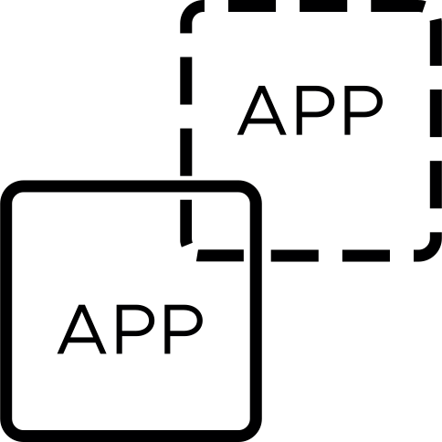
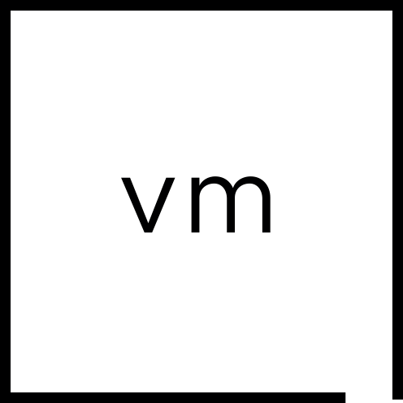
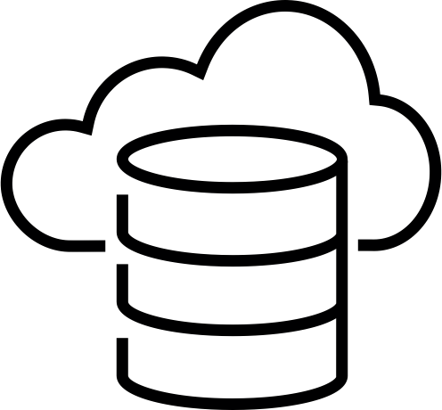



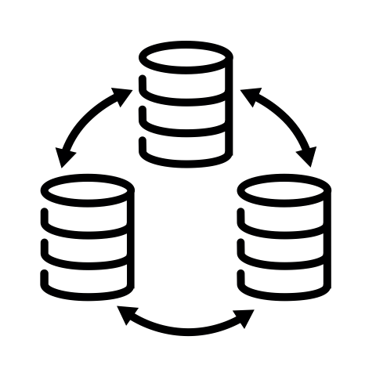
Resilience Woven Throughout VMware Cloud Foundation
Dependency
Mapping
Continuous Monitoring
Automated Patching
Data-at-Rest Encryption
VM Sandbox
Threat Detection
& Response
HCX
High Availability
Redeploy Modern App
Delta-Based
Failback
Identify
Protect
Detect
Respond
Recover
Trusted Computing Base
Application Load Balancing
Distributed Firewall
vMotion & DRS
Health
Checks
Intrusion Detection
Behavioral Analysis
VM Snapshot
Failover to
Recovery Site
Review, Audit
& Remediate
Host Attestation
Data-in-Transit Encryption
TPM & Secure Boot
Network Monitoring
Log Monitoring
Code Signing
Workload Clustering
Stretched Cluster
Isolated Recovery
Notes:
Key Message:
Security is important but resilience is the thing organizations really want, in the face of any sort of issue. The idea of resilience is woven into our platforms, and not an afterthought.
Talk Track:
And, this all ties back to operational resilience, which is really what most organizations want. The ability to use the platform to avoid, prevent, and recover quickly from issues, whether they are a failed application update, human error, ransomware attack, or a hurricane, with predictable results and costs, has been a hallmark of VMware products for decades.
This is the US National Institute of Standards and Technology’s Cybersecurity Framework 2.0, which does a good job of enumerating the idea of resilience, and again mapping Cloud Foundation functionality to the different parts. The latest version of the cybersecurity framework depicts this as a circle, with one more concept that applies to everything: governance. Governance is very important in an organization, to make sure that what the organization is doing aligns with its mission, ensure that processes are followed, inventory is kept, and so on. Doubly so now with AI technology. Not only does Cloud Foundation have all these deep resilience features, but it also has powerful governance tools through components like Aria Automation.
Notes:
Again, not a complete list of features and functionality.
References:
https://brcm.tech/vcf-security, https://sales-resources.broadcom.com/group/vcf/security-compliance

